Slide 1

Telling Your Story Template

Slide 2
LeadingAge Resources To Support Medicare Advantage Plan Engagement
Medicare Advantage Plan Engagement Toolkit Resources | Purpose of Resource
Medicare Advantage and SNP 101 | This document provides context on the Medicare Advantage program.
Medicare Advantage Supplemental Benefits Explained | This document provides an overview of and update on Medicare Advantage supplemental benefits policies and opportunities.
Medicare Advantage Engagement Strategy Checklist | This document highlights key questions to direct your organization’s education and preparation activities.
Medicare Advantage Plan Engagement Tips | This document provides an overview of new opportunities to engage health plans and an overview of how to prepare your organization.
Step-by-Step Guide to Understanding Medicare Advantage Activity in Your Market | This document provides instructions for identifying Medicare Advantage enrollment and penetration in your organization’s market.
Telling Your Story Template | This editable document provides a template for your organization to insert information on your services and value that you can provide to Medicare Advantage health plans.
Contracting Tools and Templates | This set of information provides sample contracts and exhibits, as well as editable tools to populate with your organization’s information to track contracts.
Glossary of Terms and Acronyms | This document provides a comprehensive list of terms, acronyms and definitions related to managed care and alternative payment models.

Slide 3
Telling Your Story Template: Directions
How to Use This Resource:
Fill in your organization’s information in yellow highlighted areas. Once complete with your information, remove yellow highlighting.
Adapt slides and text as necessary to highlight any high-value services or programs provided by your organization.
Delete any language that does not accurately represent your organization or services.
See talking points in notes section to help guide you through the discussion.
Delete talking points and all slides before Slide 4 prior to sharing with health plan.

Slide 4
[Month Year]
Insert Your Logo
[Your Organization Name]

Slide 5
Expanded Medicare Advantage Supplemental Benefits 2019 and Beyond
Options Through Which Medicare Advantage Plans Can Offer Supplemental Benefits:
Updated Primarily Health-Related Definition (permits optional HCBS)
(2019)
Special Supplemental Benefits for the Chronically Ill (2020)
Value-Based Insurance Design*
By Condition, Socioeconomic Status, or Both (2020)
Wellness and Health Care Planning (2020)
Telehealth (2020)
Hospice (2021)
Notes:
Goal of this slide: Set up the discussion with the health plan and introduce why you’ve requested the meeting. This is where you’ll ask about their current coverage of, or interest in, covering non-medical supplemental benefits, if you don’t already know. You should prepare for two potential conversations. 1) With plans that already offer non-medical supplemental benefit, where you would like to be a preferred partner; and 2) Plans who have not yet offered this benefit, still exploring it, and maybe even hesitant to offer it. This is a relationship that you’ll want to pursue and grow in the same way that you’d pursue any other referral relationship.
Talking points:
Through the Chronic Care Act, your health plan can now offer special supplemental benefits targeted to individual health plan members who are chronically ill.
These benefits are flexible. You can target the benefits to individuals based on their need, including non-medical home care services.
Is your plan covering these new supplemental benefits? Or do you have interest in covering them in the future?
We know, while small, this benefit and its application is unprecedented in the Medicare program, and we’re here to discuss how we can support you in implementing the benefit now or in the future.

Slide 6
Examples of Benefits that Medicare Advantage Plans Can Offer
The Centers for Medicare & Medicaid Services provides specific examples of allowable new benefits.
Examples of New Primarily Health Related Benefits plans could offer beginning in 2019
Adult day care services
Home-based palliative care
In-home support services
Support for caregivers of enrollees
Medically-approved non-opioid pain management
Stand-alone memory fitness benefit
Home & bathroom safety devices & modifications
Transportation
Over-the-counter benefits
Examples of SSBCI benefits that plans could offer beginning in 2020
Meals beyond limited basis
Food and produce
Non-medical transportation
Pest control
Indoor air quality improvement and services
Social needs benefits
Complementary therapies alongside traditional medical treatments
Services supporting self-direction
Structural home modifications
General supports for living, such as housing

Slide 7
Growing Evidence Base on In-Home and Non-Medical Interventions’ Outcomes
Program Service | Outcomes | Source
An adult day program | Reduction in 100-day rates of ER visits, hospital admissions, and days in the hospital; reduction in days of hospital stay; and days in a home care program. | The Gerontologist, The Effect of Adult Day Program Attendance on Emergency Room Registrations, Hospital Admissions, and Days in Hospital: A Propensity-Matching Study: https://academic.oup.com/gerontologist/article/57/3/552/2632072
An adult day center | Positive health-related, social, psychological, and behavioral outcomes for care recipients and caregivers. | The Gerontologist, Adult Day Care Center Programs and Their Associated Outcomes on Clients, Caregivers, and the Health System: A Scoping Review: https://www.ncbi.nlm.nih.gov/pubmed/28329856
A meal delivery program | Reduction in emergency department visits and lower use of high-cost health services for the dual-eligible population. | Health Affairs, Meal Delivery Programs Reduce The Use of Costly Health Care in Dually Eligible Medicare and Medicaid Beneficiaries: https://www.healthaffairs.org/doi/pdf/10.1377/hlthaff.2017.0999
A program offering 10 home visits by registered nurses, occupational therapists, and handymen | Reduction of Medicare expenditures by $2,765 per quarter, per patient. | Health Affairs, Innovative Home Visit Models Associated With Reductions In Costs, Hospitalizations, And Emergency Department Use: https://www.healthaffairs.org/doi/10.1377/hlthaff.2016.1305
Notes:
Note: Only use examples if relevant to services you provide.
Goal of this slide: If the plan is not familiar with the evidence base surrounding in-home interventions, you can quickly walk them through recent studies showcasing the outcomes generated by the types of services you offer.
Talking points:
The evidence base for these types of non-medical benefits, while early, is growing and promising.

Slide 8
The Opportunity
We can serve your highest cost enrollees.
We can be your eyes and ears in the community.
We are high quality and reliable.
Notes:
Goal of this slide: Drive home early and concisely what your organization offers the health plan. The points on this slide speak directly to the things that health plans care about: attracting enrollment, how much they get paid, and their ability to manage costs. Your services are an important tool in their toolbox.
Talking points:
Our organization, with the support of our LeadingAge, is prepared to help you manage your highest cost enrollees.
We can assess your enrollees and share information with your care managers and medical providers to support better outcomes. We can be your care managers’ eyes and ears.
We pride ourselves in our commitment to our clients and our ability provide them with high quality, reliable services.

Slide 9
[Your Organization Name] Overview
[Your Organization Name] is a [type of organization] provider that delivers highly personalized in-home care to meet the needs of our clients.
Population Served
Serve # clients annually with an average age of #.
Our clients typically need assistance with # of ADLs.
We have a contract with [State] Medicaid.
Other details about your population served.
Services and Programs
Non-medical services provided
Dementia programming
Meals program
Transportation program
Community partnerships
Geography served
# of years in business (reliability)
Key referral partners
Technology and Software
Flexible software infrastructure with ability to submit/track claims electronically.
Electronic visit verification.
Ability to share information in a secure portal.
Ability for health plans/care managers to build custom assessments.
Ability to share care plans and assessments with clinical care teams.
Notes:
Goal of this slide: Describe your organization’s services, population served, capabilities, partnerships, and information sharing capabilities. Edit the bullets on the slide and talking points below to more accurately reflect your population and services.
Talking points:
We serve [NUMBER] of clients annually with an average age of [X]. These individuals, on average, need assistance with [NUMBER] of ADLs. We also have a contract with [STATE] Medicaid.
We offer a variety of services to meet the unique needs of our clients. These include skilled care, such as medication administration, post-surgical care, wound management, and chronic disease management. We also offer a range of non-skilled services, such as personal care, transportation, home safety evaluation, fall risk assessments, and meal preparation. We also have experience coordinating with all members of our clients’ care teams.
Our services are supported by a technology platform that enables electronic visit verification and seamless claims submission. Our platform also gives us the ability to work with you to build custom assessments to ensure we meet the exact needs of each of your plan members.
[Ask what the services and capabilities matter most to the health plan]

Slide 10
[Your Organization’s] Commitment to [Name of Health Plan]
Value for [Name of Health Plan] |  | Value of [Your Organization] |  | Value for Your Enrollees
Compliance with health plan care models and care coordination efforts. Standard, timely transmission of assessments, plan of care, visit verification, and other required data elements. % of our clients are enrolled in your plan. % client and family satisfaction score. Commitment to client satisfaction and retention. |  | Understand importance of integrated service delivery. Ability to communicate with medical providers, other community-based organizations, and care coordinators. Ability to recognize issues and change in status. Updated policies on hiring and training requirements and processes. Licenses/certifications that are relevant. Ability to collect outcomes data (e.g., hospitalizations, readmissions). |  | Seamless integration of medical and non-medical services. Introduction to the value of home care and non-medical services for members/ family/ caregivers who have no previous experience.
Notes:
Goal of this slide: Drive home the value you bring to the health plan and its members. Health plans need to know that you’ll comply with their model of care; can offer standard, timely transmission of information; and are committed to client satisfaction. Edit the information on the slide and in talking points below to more accurately reflect your population and services. Delete bullets if they do not apply; however, if you believe you can implement these processes, keep them and clarify you are developing the capability.
Talking points:
We believe our organization will provide value to you and your membership.
We are prepared to comply with your model of care and will do so in a standardized, timely way that is seamless for you and your members.
We understand that integrated care delivery is the key to managing complex patient populations. We have experience working directly with our clients’ care teams and communicating change in status in a timely way. Through our software platform, we also have the ability to track outcomes data most important to you, such as hospitalizations and readmissions.

Slide 11
We Serve the Highest Cost Medicare Beneficiaries
Key Takeaways
When a person has moderate functional impairment, they are more than twice as expensive to Medicare than someone who does not have functional impairment, even when they have multiple chronic conditions.
Our clients are health care’s most expensive patients.
Notes:
Goal of this slide: End your value proposition by showing that while the new special supplemental benefit flexibility is targeted to those with chronic conditions, those who have functional impairment are actually the highest cost. These people are your clients!
Talking points:
When a person has moderate functional impairment, they are more than twice as expensive to Medicare than someone who does not have functional impairment, even when they have multiple chronic conditions.
Health care’s most expensive patients are those you’ll be targeting with your benefit. This is also the population that [Your Organization] is skilled at caring for!

Slide 12
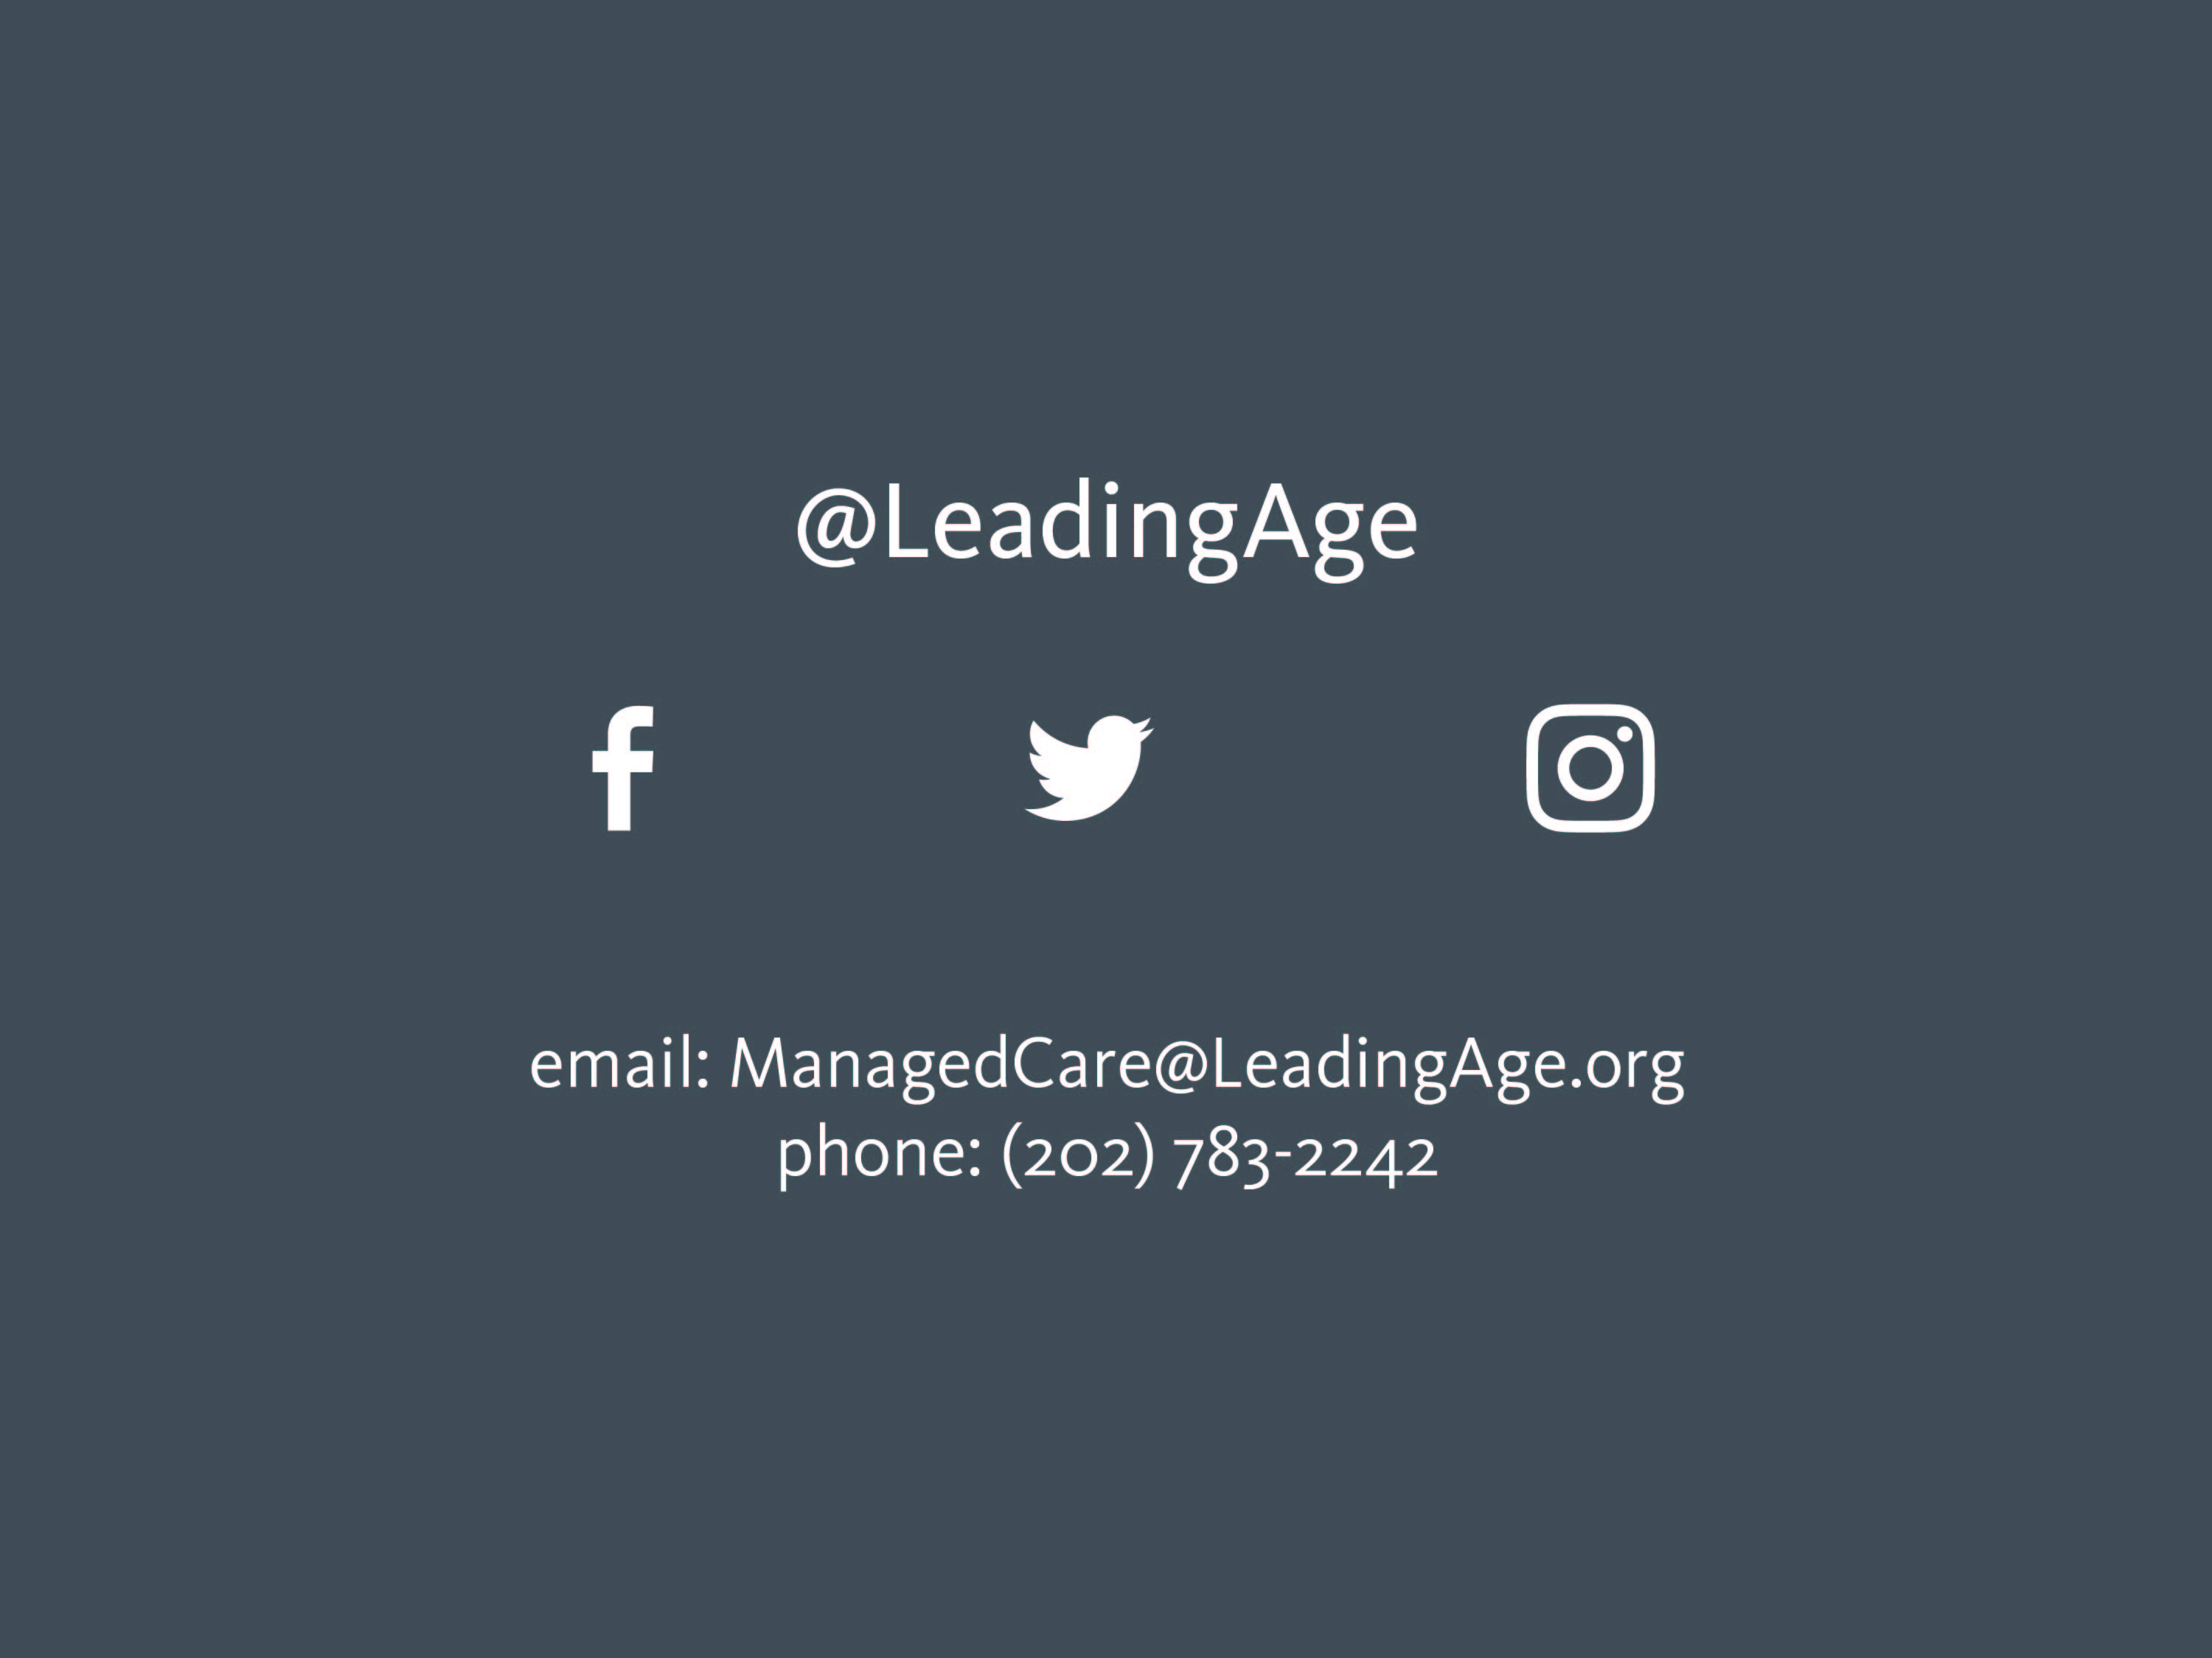
CONNECT WITH US

