Slide 1
LeadingAge Annual Meeting
Karen Tritz
Division of Nursing Homes, QSOG

Slide 2
Overview
LTC Survey Process – Approaching 1 year old…
Phase 3 and Nursing Home Oversight
Facility Reported Incidents
Immediate Jeopardy
PBJ Audits
Time-limited waivers – Life Safety Code

Slide 3
Top Deficiencies - Recertification
New Survey Process |  | FY2017 Surveys
F880 | Infection Prevention | F0441 | Infection Prevention
F812 | Food Procurement – Storage | F0371 | Food Procurement – Storage
F656 | Comprehensive Care Plan | F0323 | Accident & Supervision
F689 | Accident & Supervision | F0309 | Quality of Care
F761 | Label/Store Drugs | F0431 | Label/Store Drugs
F657 | Care Plan Timing and Revision | F0329 | Free from Unnecessary Meds
F684 | Quality of Care | F0279 | Develop Comp Care Plans
Notes:
New Survey Process – FY2017

Slide 4
Effectiveness?
 | Number Invest/ Surveyor | Total Investigation /Survey | Average # Deficiencies
FY2017, Trad |  |  | 5.8
FY2017, QIS | 5.3 | 23
April | 11.60 | 55.90 | 6.26
May | 11.42 | 55.52 | 6.5
June | 11.47 | 55.26 | 6.5
July | 11.41 | 54.72 | 6.6
August | 11.38 | 54.16 | 6.5

Slide 5
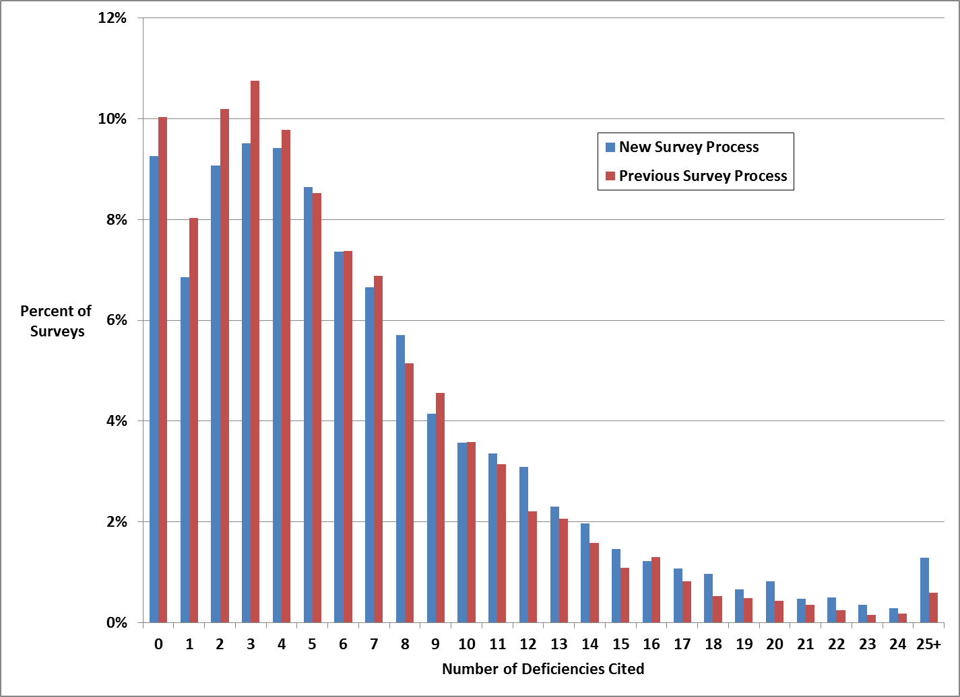
Number of Deficiencies Cited

Slide 6
Efficiency – Results to date
 | Team Size | Time/ Surveyor
FY2017, Trad | 4.4 | 23.08
FY2017, QIS | 4.4 | 28.6
April | 5.15 | 27.80
May | 5.13 | 27.48
June | 5.08 | 27.21
July | 5.06 | 26.97
August | 5.01 | 26.67

Slide 7
Nursing Home Oversight and Phase 3
Phase 3 – Effective 11/28/19
Unfreezing the Health Inspection Rating on Nursing Home Compare

Slide 8
Other Policy Issues
Immediate Jeopardy – Revisions to Appendix Q
Clarification of Facility Reported Incidents

Slide 9
Facility Actions
Facility
Report
Review
Action
Notes:
Reporting – What?
Facility Actions (Investigation and Remediation)
Intake
Triage and Prioritization
Systems – ACTS

Slide 10
State Survey Actions
State Agency
Investigate
Triage-Follow-up
System

Slide 11
Payroll Based Journal Audit
Selection (Two types – targeted/general)
Notification
Entrance Conference with Provider
Timely Upload of Requested Data to FTP site.
Post audit: Findings are documented and sent to facility:
No issues
Slight variances = Information and expectation to correct.
Significant Issues or No response = Assigned one-star staffing rating (for 3 months)
One-star staffing rating reduces a facility’s overall rating by one star
Notes:
Facilities are selected for audits based on data analysis.
Facilities receive a letter informing them of the audit, and requesting information to be uploaded to a secure server (letter is from Myers and Stauffer, the audit firm contracted by CMS).
Facilities have 5 business days to submit the requested data to a secure FTP site.
Significant variances between data submitted and verified: Assigned one-star staffing rating
Slight variances w/policy issues: Facility informed of issues with expectations to correct in future quarters
Initially, I had included this bullet point on the first slide but this was cut when I reviewed the slides with Evan.
There are two types of audits:
Targeted audits looking at a specific issue which may indicate inaccurate reporting and;
General audits looking at overall PBJ reporting
The talking points went on to explain the audits currently being done as follows:
There are two types of audits being done currently.
Targeted audits are a shortened version of the audit process. These audits focus on specific data anomalies found in the facility’s submitted data. (An example of this would be a facility with an employee or employees working more than 400 hours in a one month period.)
General audits (also called off-sites) cover all aspects of the PBJ reporting requirements. Auditors are checking the accuracy of the staffing data being reported and verifying that the facility is following all CMS policy related to PBJ. Myers and Stauffer does an entrance conference with providers for all off-sites. They discuss process, time line and go through an entrance questionnaire where they ask a series of questions about how the facility submitted data for PBJ. At the conclusion of the audit, the auditors discuss the findings with the facility. If the audit results in actions taken against the provider, a formal report is provided.
All of the audits being done currently are off-site (whether they are targeted (also called short form) or the full off-site audit. I revised the talking points so that they don’t start post audit but still did not mention the two types. If you think this should be part of your presentation, let me know and I will revise accordingly.

Slide 12
PBJ Lessons Learned – Avoid Common Errors
Exclude time for meal breaks
Assign unique IDs to employees
Complete MDS assessments for all residents
Subtract hours for staff providing care to individuals who are not in certified facility
Avoid submitting corporate staff hours for non-direct care
Have an RN onsite every day and report correctly
Have CNA’s onsite every day and report correctly
Questions? email NHStaffing@cms.hhs.gov

Slide 13
Time Limited Waivers – Life Safety Code
Requested by the facility to allow for an extended timeframe to correct a deficiency found on a Life Safety Code survey.
Delays the imposition of remedies that could be imposed at 90 days and at 6 months.
Applies only to life safety code deficiencies.
Notes:
A time limited waiver is a waiver that holds life safety enforcement actions in abeyance for a specific period of time as requested by the facility. It is requested when a life safety code deficiency cannot be corrected in less than 90 days. .

Slide 14
Time Limited Waivers - LSC
Requested on the Plan of Correction with justification
Include a timetable with milestones of activities to correct.
Address: Increased fire safety awareness in the facility may be required depending on type of work being done:
A fire watch may be needed in the facility
An increase in fire drills and staff training
Temporary installation of additional fire detection in affected area may be needed
Notes:
A time limited waiver is a waiver that holds life safety enforcement actions in abeyance for a specific period of time as requested by the facility. It is requested when a life safety code deficiency cannot be corrected in less than 90 days. .

Slide 15
Time Limited Waivers
Process:
Reviewed by the State Agency
Recommend approval/disapproval to CMS Region
CMS Region approves/disapproves and returned to facility
Notes:
A time limited waiver is a waiver that holds life safety enforcement actions in abeyance for a specific period of time as requested by the facility. It is requested when a life safety code deficiency cannot be corrected in less than 90 days. .

Slide 16
Time Limited Waivers - Example
A fire rated door has to be ordered and delivery is not expected for 3 months with installation taking another 2 weeks
A time limited waiver could be asked for a period of 4 months when the POC is originally submitted by the facility. This would delay the imposition of remedies for the period requested.

Slide 17
Time Limited Waivers-FSES
A Special Example:
This applies only to health care facilities using the FSES
that do not achieve a passing score on the FSES
S&C: 17-15 Use of the Fire Safety Evaluation System (FSES), National Fire Protection Association (NFPA) 101A, Guide on Alternative Approaches to Life Safety, 2013 Edition by Health Care Occupancies and Board and Care Occupancies
Extends Timeframe for Compliance: 5 years
Waiver is approved and granted by CMS RO

