Slide 1
Restorative Nursing Competency
Staff Training
Notes:
Hello and Welcome to the program on competency with the Restorative Nursing Program

Slide 2
Objectives
Upon completion of the program, attendees should be able to:
Obtain a basic understanding of the RoP for Restorative Nursing and Competencies
Describe the components of a Restorative Nursing Program
Describe essential documentation requirements for the Restorative Nursing Program

Slide 3
CMS: State Operations Manual
https://www.cms.gov/Regulations-and-Guidance/Guidance/Manuals/downloads/som107ap_pp_guidelines_ltcf.pdf
Notes:
We will start out talking about the new revised requirements for long term care facilities
The CMS State Operations Manual, Appendix PP addresses:
“Provide necessary care and services to help each resident attain or maintain their highest practicable physical, mental, and psychosocial well-being.”
Established standards of practice for facilities to ensure that the resident obtains optimal improvement or does not deteriorate within the limits of the resident’s rights to refuse treatment, and within the limits of recognized pathology and the normal aging process.

Slide 4
Federal Tags
F tags that could be cited during a survey inspection:
F684 Quality of Care
F676 Activities of Daily Living –Maintain Abilities
F677 ADL Care Provided for Dependent Residents
F686 Pressure Sores
F690 Incontinence
F688 Increase/Prevent Decrease in Range of Motion/Mobility
F636 Comprehensive Assessments & Timing
F656 Comprehensive Care Plans
F658 Services Provided Meet Professional Standards
F689 Free of Accident Hazards/Supervision/Devices
F725 Sufficient Nursing Staff
Notes:
These are some of the F-tags that surveyors could identify as a concern if the facility does not have a solid Restorative Program in place.

Slide 5
Restorative Programs
Based on resident’s identified needs and preferences
Need to be planned, organized and documented (not part of routine care)
At least 15 minutes/day – for EACH program coded
Programs aimed towards improving or maintaining function
Care Plan should identify individualized goals and interventions (ongoing review for revisions)
Notes:
Promoting a higher level of function requires:
Identification of what the resident actually does for him/herself
Identification of assistance needed and what level
24/7 view must be observed - residents vary
Multiple sources are required in the assessment

Slide 6
RAI Manual
“Restorative nursing program refers to nursing interventions that promote the resident’s ability to adapt and adjust to living as independently and safely as possible. This concept actively focuses on achieving and maintaining optimal physical, mental, and psychosocial functioning.”
Notes:
The RAI Manual also indicates: “A resident may be started on a restorative nursing program when he or she is admitted to the facility with restorative needs, but is not a candidate for formalized rehabilitation therapy, or when restorative needs arise during the course of a longer-term stay, or in conjunction with formalized rehabilitation therapy. Generally, restorative nursing programs are initiated when a resident is discharged from formalized physical, occupational or speech rehabilitation therapy.”
(MDS 3.0, RAI Manual, Pg. 0-37)

Slide 7
Let’s Take a Look at the Programs
Toileting Program
Passive Range of Motion (PROM)
Active Range of Motion (AROM)
Splint or Brace Assistance
Bed Mobility
Transfer
Walking
Dressing and/or Grooming
Eating and/or Swallowing
Amputation/Prostheses Care
Communication
Notes:
These are the restorative programs and they are listed in Section H and Section O=O0500 on the MDS. Directions for each program are outlined in the MDS 3.0 RAI Manual.
NOTE: ALL programs MUST be implemented as care planned for the number of days per week unless resident refuses (than the CNA must notify the nurse) or if there is a contraindication that is discussed with the nurse

Slide 8
Assessment Process
The first step is determining a need for a Restorative Nursing program.
ADL tracking/coding
Functional ADL Assessment
Range of Motion Screening/Assessment
Bowel and Bladder Assessment
If there is a deficit, why would we not have the resident in a program?
Notes:
Since each Restorative Program must be individualized, we need to complete an assessment to determine each resident’s unique needs.
(Read slide)
Residents can decline and here are a few reasons why a resident can lose functional ability
Cognitive deficits
Physical/neurological deficits
Stamina
Muscle tone
Balance
Bone strength
Side effect of medications
Additional assessments that can be important with the Restorative assessment process include:
Other assessments with a direct relationship to Restorative Nursing include:
Pain Assessment
Safety Risk or Fall Assessment
Nutritional Assessment
Cognitive Assessment
Mood and Behavior Assessments
Skin Risk Assessment

Slide 9
Components of Restorative Nursing Program
Notes:
Now we will discuss each program briefly-individually

Slide 10
Range of Motion Exercises
The MDS 3.0 RAI Manual describes Range of Motion as:
Passive Range of Motion (PROM): “Code provision of passive movements in order to maintain flexibility and useful motion in the joints of the body.”
CMS, MDS 3.0 RAI Manual, Page O-38
Notes:
• For range of motion (passive): the caregiver moves the body part around a fixed point or joint through the resident’s available range of motion. The resident provides no assistance.

Slide 11
Range of Motion Exercises
Continued:
Active Range of Motion (AROM): “Code exercises performed by the resident, with cueing, supervision, or physical assist by staff that are individualized to the resident’s needs, planned, monitored, evaluated, and documented in the resident’s medical record.”
CMS, MDS 3.0 RAI Manual, Page O-38
Notes:
More definitions include:
**For range of motion (active): any participation by the resident in the ROM activity should be coded here
**Note: AROM and AAROM are both coded under AROM

Slide 12
F688: Mobility
DEFINITIONS from the CMS State Operations Manual:
“Active ROM” means the performance of an exercise to move a joint without any assistance or effort of another person to the muscles surrounding the joint.
“Active Assisted ROM” means the use of the muscles surrounding the joint to perform the exercise but requires some help from the therapist or equipment (such as a strap). Mobility refers to all types of movement, including walking, movement in a bed, transferring from a bed to a chair, all with or without assistance or moving about an area either with or without an appliance (chair, walker, cane, crutches, etc.).”
https://www.cms.gov/Regulations-and-Guidance/Guidance/Manuals/downloads/som107ap_pp_guidelines_ltcf.pdf
Notes:
CMS also defines Active and Passive Range of Motion in the CMS State Operations Manual which is the Federal rules for nursing facilities to comply with.

Slide 13
GROUP AROM
Group restorative/rehabilitative AROM programs can be highly effective and enjoyable for residents.
Groups cannot be more than 4 residents to 1 caregiver/leader.
The caregiver/leader must be aware of the goals and approaches of each individual within the group.
Groups of 4:1 or less allow for individualized attention within the group.
Notes:
It is acceptable to use groups when appropriate but there are rules for group restorative programs

Slide 14
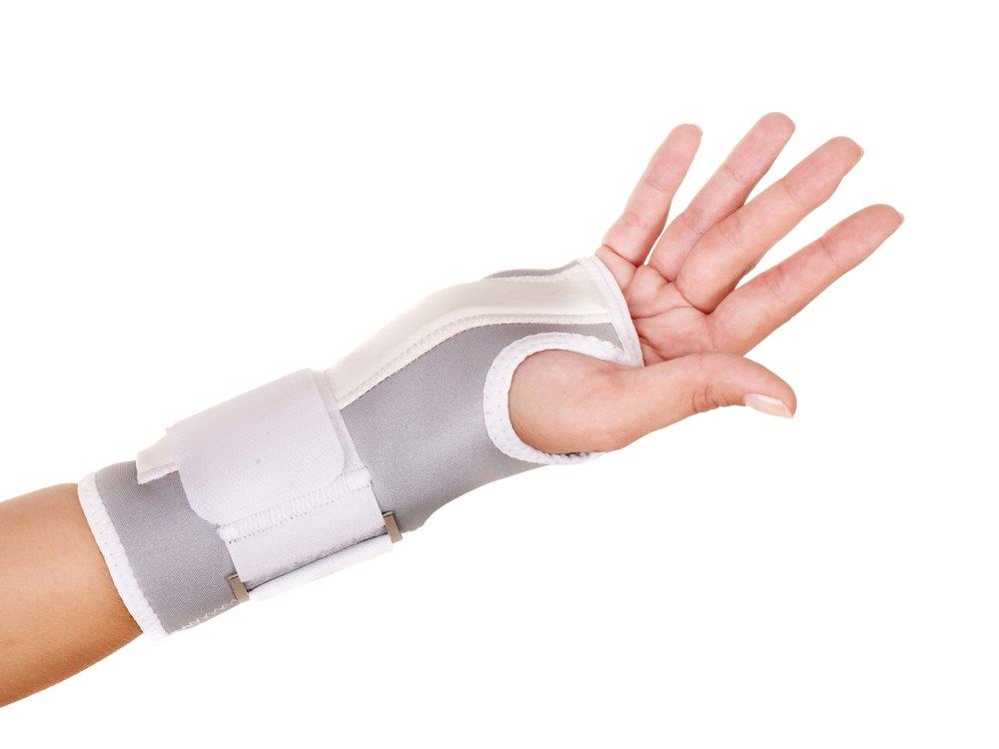
Splint or Brace Assistance
“Code provision of
verbal and physical guidance and direction that teaches the resident how to apply, manipulate, and care for a brace or splint; or
a scheduled program of applying and removing a splint or brace. These sessions are individualized to the resident’s needs, planned, monitored, evaluated , and documented in the resident’s medical record.”
RAI Manual, Chapter 3, Page O-38
Notes:
Most of the time the residents fall under #2-a scheduled program of applying and removing a splint or brace. You will need to follow the directions on the care plan. Most times the instructions will describe range of motion prior to application. It is also imperative that all staff observe for any pain or skin integrity concerns. You will need to report any concerns to the nurse.

Slide 15
Bed Mobility
“Code activities provided to improve or maintain the resident’s self-performance in moving to and from a lying position, turning side to side and positioning himself or herself in bed. These activities are individualized to the resident’s needs, planned, monitored, evaluated, and documented in the resident’s medical record.”
RAI Manual, Chapter 3, Page 0-39
Notes:
Directions from the MDS 3.0 RAI Manual

Slide 16
Transfer
Includes “activities provided to improve or maintain the resident’s self-performance in moving between surfaces or planes either with or without assistive devices. These activities are individualized to the resident’s needs, planned, monitored, evaluated, and documented in the resident’s medical record”
MDS 3.0 RAI Manual, Pg. O-38
Notes:
All staff transferring resident must be trained in resident transfer and gait belts must be used according to facility procedure (describe). It is essential that the CNA follows the resident care plan and ensure resident is wearing proper footwear. Resident should be encouraged to participate as much as possible in the process

Slide 17
Walking
Planned and organized program based on resident’s individualized needs:
Distance
Staff Assistance
Assistive Devices
Special Considerations
Surfaces consideration (tile, carpet, cement, grass, etc.)
A facility wide “walk-to-dine” may be appropriate for some residents but not all!
Notes:
MDS RAI Manual indicates to Code activities provided to improve or maintain the resident’s self-performance in walking, with or without assistive devices. The program should be individualized to the resident specific needs.

Slide 18
Dressing
Dressing - Selecting, obtaining, putting on, fastening (buttons, snaps, zippers, Velcro, laces), taking off all items of clothing, and putting on and removing braces and artificial limbs, socks and shoes, accessories (belts, jewelry, scarf tying, and knotting a tie).
Notes:
Code activities provided to improve or maintain the resident’s self-performance in dressing and undressing, bathing and washing, and performing other personal hygiene tasks. Each program must be at least 15 minutes and when you are providing this program, you can use the time to SELECT AND OBTAIN the items—because you are working with the resident in being able to become more independent with the goal of them doing as much as they can and that will include the entire process—selecting, obtaining and putting on/off all items.

Slide 19
Grooming
Grooming - Maintaining personal hygiene, including planning the task and gathering supplies, combing and/or styling hair, washing face and hands, brushing teeth, shaving or applying make-up, oral hygiene, self manicure (safety awareness with nail care), and/or application of deodorant or powder.
Notes:
Code activities provided to improve or maintain the resident’s self-performance in dressing and undressing, bathing and washing, and performing other personal hygiene tasks. For this program, you again, can include the time to plan which items, obtain and them provide the interventions in the program.

Slide 20
Dining Programs
Purpose
Dining programs are designed to maintain or improve safe dependent or self-feeding ability, maintain or improve nutrition/hydration status, and enhance socialization and self-esteem.
Can be 2 types:
Eating
Swallowing
Notes:
Code activities provided to improve or maintain the resident’s self-performance in feeding oneself food and fluids, or activities used to improve or maintain the resident’s ability to ingest nutrition and hydration by mouth. In order to code this program, resident can be in either the eating or swallowing program (or even both if it applies).

Slide 21
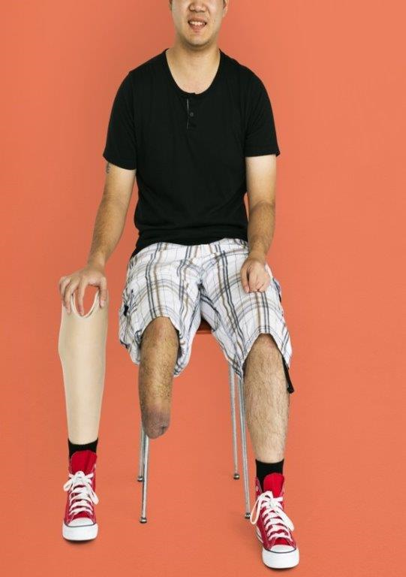
Amputation/Prosthesis Care
Includes “activities provided to improve or maintain the resident’s self-performance in putting on and removing a prosthesis, caring for the prosthesis, and providing appropriate hygiene at the site where the prosthesis attaches to the body”
-MDS 3.0 RAI Manual, Chapter 3, Pg. O-39
Notes:
As you can see – this program even includes providing appropriate hygiene (and monitoring of skin integrity)

Slide 22
Communication
“Code activities provided to improve or maintain the resident’s self-performance in functional communication skills or assisting the resident in using residual communication skills and adaptive devices.”
RAI Manual, Chapter 3, Page 0-39
Notes:
Communication programs can include teaching residents how to successfully use a communication board, or even using paper handouts on tracing letters, writing words and more! Most facilities will communicate with the Speech Therapist to continue successful interventions once formal Speech Therapy is discontinued.

Slide 23
Toileting Programs
Notes:
Toileting Programs ARE part of Restorative Nursing. If a resident is incontinent, a full evaluation of the resident’s pattern and assessment to determine an individualized program that staff must adhere to. Discuss the facility requirement for a 3 day diary AND the Bowel and Bladder Evaluation/Assessment Form

Slide 24
Toileting Programs
Based on a 3 day diary for determination of accurate, individualized pattern; followed by a nurse assessment determining:
Prompted Voiding Program
Scheduled/Habit/Timed Program
Bladder Training
**It is imperative that the 3 day is accurate!
Notes:
Once the program is identified, it will need to be care planned and staff must follow the program. Dependent changing of a brief is not considered a toileting program

Slide 25
Toileting Programs
Scheduled toileting plans are formal plans that must be followed as indicated in the care plan
The toileting plan/program must be resident specific
**don’t count check and change programs
Bladder Training is a short term program
The goal is to reduce incontinent episodes

Slide 26
O0500 Restorative Nursing-MDS
In order to code Section O0500 for Restorative Nursing Programs, there must be documented evidence in the medical record for at least 15 minutes/day for each program during the ARD look back period. (We need to document actual minutes)

Slide 27
Fecal Incontinence
Notes:
Symptoms or types of Fecal Incontinence may include:
“Passive incontinence — which is the involuntary discharge of fecal matter or flatus without any awareness. This suggests a loss of perception and/or impaired rectoanal reflexes either with or without sphincter dysfunction;
Urge incontinence — which is the discharge of fecal matter or flatus in spite of active attempts to retain these contents. Here, there is a predominant disruption of the sphincter function or the rectal capacity to retain stool; and/or
Fecal seepage — which is the undesired leakage of stool, often after a bowel movement with otherwise normal continence and evacuation. This condition is mostly due to incomplete evacuation of stool and/or impaired rectal sensation. The sphincter function and pudendal nerve function are mostly intact”.
https://www.cms.gov/Regulations-and-Guidance/Guidance/Manuals/downloads/som107ap_pp_guidelines_ltcf.pdf

Slide 28
Fecal Incontinence
Potential Treatments/interventions (based upon the type) of Fecal Incontinence
Eating increased amounts of fiber;
Drinking sufficient liquids;
Use of medications to develop more solid stools that are easier to control;
Pelvic Floor Exercises and Biofeedback that strengthen the pelvic floor muscles may improve bowel control.
Surgery may be an option for fecal incontinence that fails to improve with other treatments or for fecal incontinence caused by pelvic floor or anal sphincter muscle injuries;
Electrical Stimulation
https://www.cms.gov/Regulations-and-Guidance/Guidance/Manuals/downloads/som107ap_pp_guidelines_ltcf.pdf
Notes:
New regulatory language
Care Plan
“For the resident with fecal incontinence, the care plan must reflect the results of the resident’s assessment and include resident specific interventions for any potential reversible causes and, if irreversible, appropriate interventions for management of fecal incontinence. Interventions and the provision of care should address treating the resident with respect, enhancing dignity and self-worth and reducing embarrassment and shame in relation to FI.

Slide 29
Person Centered PLANNING
If we follow the Process as it is INTENDED, Person Centered Care Planning is possible!!
Admission Assessment
Ancillary Assessments
Resident/Family Involvement
RAI Process

Slide 30
Communication Essentials with the Restorative Nursing Program
Notes:
It is imperative that there is good communication of resident assessment, plan of care, implementation expectations, change of condition such as pain, inability to perform the program, endurance, SOB, etc. and refusals in order for the nurse to discuss the risks and benefits of programs and attempt to identify reasons why (such as pain) in order to offer alternatives. This way we know the resident is making an informed choice.
Formal Therapy to Nursing
Restorative Nurse to CNA
Restorative Nurse to RNA
Restorative Nurse to Charge Nurse
CNA/RNA to Restorative Nurse
Nurse to Physician
Nursing to Therapy
Nursing to Resident
Nursing to Resident Representative
Nursing to Activities
Nursing to Dietary

Slide 31
C.N.A. Education
Purpose of Restorative Nursing
Basic Components of the MDS Based Restorative Nursing Program
C.N.A.’s need to be trained in the techniques that promote resident involvement in the activity
Groups for Restorative Nursing
Notes:
CNAs MUST be trained in the techniques that promote resident involvement in the activity per the CMS RAI Manual

Slide 32
C.N.A. Education
Common Obstacles to Attainment of Restorative Goals
Each Program is a separate, PLANNED event
Activities and Tasks of each program, including skills and return demonstration
Consistent implementation of care plan interventions
Benefits of a Restorative Program

Slide 33
Documentation to Substantiate Program Implementation and MDS Coding
Notes:
Now we will discuss MDS Coding and the documentation that will be necessary to support the MDS-for both regulations and for reimbursement

Slide 34
MDS Coding Documentation
Section G: ADL Documentation
Identifies the need for the program
Need to have “proof” during the observation period
All shifts
Include # episodes
Ensure staff understand the MDS 3.0 RAI Manual definitions/instructions
Notes:
Section G: ADL Documentation
Limited vs. Extensive Assist - it’s all about weight bearing assistance!
Examples
“Holes” in tracking
MDS coder doesn’t agree with tracking
“Copycat” tracking
Tracking once/shift
Staff track what they “think” the resident can do

Slide 35
Implications of Section G
Dollars/Reimbursement
Resident Care
Quality Measures: One of the Quality Measures that potentially looks at Restorative includes: “Percent of residents whose need for help with activities of daily living has increased.”
Survey: What do surveyors look at when there is a decline in ADL’s?
Notes:
If there is a decline in ADL’s surveyors will investigate if it is due to staff not providing proper care!

Slide 36
ADL Coding for the MDS 3.0
It is imperative that the ADL documentation substantiates the MDS Coding.
Remember, the MDS gathers information on the resident’s actual function—not what staff think the resident can do.

Slide 37
MDS Section H
Remember, the MDS is not a primary source document, therefore, you will need evidence of documentation to substantiate:
A trial or current toileting program and response (H0200)
How are you able to objectively determine (and prove by documentation) response to trial program if coded?
Urinary Incontinence
Do you have a system to capture 7 days of monitoring for continence in order to code?
Notes:
This is why it is essential to document resident incontinent episodes.

Slide 38
MDS O0500: Restorative Nursing
There will need to be documented evidence of 15 or more minutes a day, in the 7 day look back (observation period) for EACH program that was performed
Notes:
This is a requirement. The 15 minutes must be for EACH program EACH day for the number of days coded on the MDS

Slide 39
Documentation for Restorative Nursing
Assessment Process
Ancillary Assessments
Range of Motion
Functional ADL
Bowel and Bladder
Balance
MDS and CAA’s
ADL’s
Continence and Toileting Documentation
Minutes of Restorative Programs

Slide 40
Documentation - continued
Person Centered Care Plan (original and revisions)
Implementation Records for C.N.A.’s
C.N.A./Restorative Aide documentation
Monthly Charting
Change of Condition Charting
Quarterly Review (progress, participation, resident response to programs over the quarter)
State Specific charting-some states have specific requirements.

Slide 41
Documentation: Therapy Involvement
Formal Communication (written and verbal) when Formal Therapy discharges resident from therapy to include:
Current functional status
Appropriate Goal
Interventions
Once therapy discharges and resident is in a Restorative Program, the program is under the direction of nursing.

Slide 42
Putting it all Together
Once you have all of your data and assessment information, a decision will be made on the program goals and interventions for each individual resident-including RESIDENT/FAMILY input, a care plan is completed, C.N.A. documentation is prepared and communication is essential!

Slide 44
References
MDS 3.0 RAI Manual:
https://www.cms.gov/medicare/quality-initiatives-patient-assessment-instruments/nursinghomequalityinits/mds30raimanual.html
CMS, State Operations Manual, Appendix PP:
https://www.cms.gov/Regulations-and-Guidance/Guidance/Manuals/downloads/som107ap_pp_guidelines_ltcf.pdf

Slide 45
Disclaimer
“This presentation provided is copyrighted information of Pathway Health. Please note the presentation date on the title page in relation to the need to verify any new updates and resources that were listed in this presentation. This presentation is intended to be informational. The information does not constitute either legal or professional consultation. This presentation is not to be sold or reused without written authorization.”

