Slide 1
Specialized Rehabilitation Services Competency
Staff Training
Notes:
Welcome to the session on Specialized Rehabilitation Services, qualifications and how it aligns with the facility resource assessment. Facilities are required to perform a facility wide resource assessment that takes a good look at our resident population in order to be able to provide resources—both staff and other resources- to provide quality of care for our residents. Today, we will be discussing how Specialized Rehabilitation Services fits into the facility assessment as well as the importance of interdisciplinary involvement in collaboration of Specialized Rehabilitation Services to meet the needs of the resident

Slide 2
Objectives
Upon completion of the program, attendees should be able to:
Describe how the Facility Assessment is used with determining resources for Specialized Rehabilitation Services
Describe who is included in “qualified personnel” for Specialized Rehabilitation Services
Verbalize the requirement that qualified personnel must have competencies and skill sets to care for residents as identified through resident assessment and described plan of care
Verbalize position responsibility with care plan interventions with Specialized Rehabilitation Services
Notes:
Read the objectives above

Slide 3
Regulations
Notes:
The Requirements of Participation include the Federal regulations that Long Term Care Facilities must comply with. We will talk about the specific regulations that revolve around Specialized Rehabilitation Services

Slide 4
Includes but is not limited to physical therapy, speech-language pathology, occupational therapy, or respiratory therapy and are provided or arranged for by the nursing home.
They are “specialized” in that they are provided based on each resident’s individual assessed rehabilitative needs based on their comprehensive plan of care and can only be performed by or under the supervision of qualified personnel.
Notes:
Speaker Notes;
Read the slide.
These services must be provided by the facility or an outside resource and delivered by qualified personnel as defined below in the guidance under tag F826 and who are acting within the State’s scope of practice laws and regulations.
Care provided by all facility staff must be coordinated and consistent with the specialized rehabilitative services provided by qualified personnel,

Slide 5
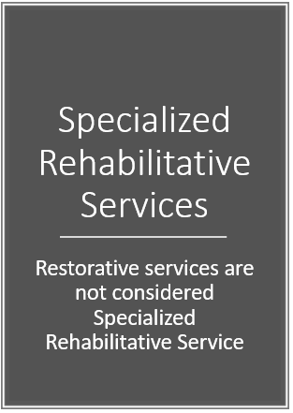
Restorative services are not considered Specialized Rehabilitative Service
Notes:
Speaker Notes.
Read the slide.
As referenced in Section O of the MDS/RAI manual - Restorative services refers to nursing interventions that promote the resident’s ability to adapt and adjust to living as independently and safely as possible.
Generally, restorative nursing programs are initiated when a resident is discharged from formalized physical, occupational, or speech rehabilitation therapy e.g., Specialized Rehabilitation Services

Slide 6
Notes:
Speaker Notes.
In order to start formal therapy, we need to ensure we have an order. For new admissions, readmissions or residents who have a change in condition who would benefit from formal specialized rehabilitative services, a physician order is required.

Slide 7
Notes:
Upon admission, readmission or change of condition, resident’s will be evaluated and this includes information from the hospital as well, in order to determine resident needs with specialized rehabilitation, goals of care (such as going home, assisted living or another setting)

Slide 8
Notes:
The resident has the right to be informed and make treatment decisions regarding their treatment plan and the care-including the type of care as well as the type of professional that will furnish that care

Slide 9
Specialized Rehabilitative Services
“Qualified Personnel”:
Physical Therapist
Occupational Therapist
Respiratory Therapist
Speech-Language Pathologist
Physician
Nurse Practitioner
Clinical Nurse Specialist
Physician’s Assistant
***who is licensed or certified by the state to furnish therapy services.
https://www.cms.gov/Regulations-and-Guidance/Guidance/Manuals/downloads/som107ap_pp_guidelines_ltcf.pdf
Notes:
Speaker Notes:
The facility must employ either directly or contract with an outside resource the appropriate qualified personnel as defined above, and additional support staff to ensure the needs of the residents are met in accordance with their comprehensive plan of care.” Centers for Medicare & Medicaid Services State Operations Manual, Appendix PP – Guidance to Surveyors for Long Term Care Facilities (Rev. 173, 11-22-17): https://www.cms.gov/Regulations-and-Guidance/Guidance/Manuals/downloads/som107ap_pp_guidelines_ltcf.pdf

Slide 10
“Qualified Personnel”
May also include a physical therapist assistant (PTA), or an occupational therapy assistant (OTA) when furnishing services under the supervision of a qualified therapist
https://www.cms.gov/Regulations-and-Guidance/Guidance/Manuals/downloads/som107ap_pp_guidelines_ltcf.pdf
Notes:
Speaker Notes:
According to State Law. Many times the PTA or the OTA will be furnishing services. They also must have evidence of educational preparation, competency and ongoing inservicing to ensure they are competent to perform their duties. The will work under the supervision of the qualified therapist.

Slide 11
The facility must provide or arrange for the provision of specialized rehabilitative services to all residents that require these services for the appropriate length of time as assessed in their comprehensive plan of care.
These services are considered a facility service provided to all residents who need them based on their comprehensive plan of care and are included within the scope of facility services.
https://www.cms.gov/Regulations-and-Guidance/Guidance/Manuals/downloads/som107ap_pp_guidelines_ltcf.pdf
Notes:
Speaker Notes:
Read the slide.
If facility doesn’t employ staff for theses services, the facility must obtain specialized rehabilitative services from an outside resource that is a provider of specialized rehabilitation services that is NOT excluded from participating in any federal or state health care program. These personnel must have the training, competencies and skill sets to care for residents as identified through resident assessments, and described in the plan of care. The qualified personnel must meet the requirementt of the facility assessment.

Slide 12
Specialized Rehabilitative Services
The facility must employ either directly or contract with an outside resource the appropriate qualified personnel as defined above, and additional support staff to ensure the needs of the residents are met in accordance with their comprehensive plan of care.
https://www.cms.gov/Regulations-and-Guidance/Guidance/Manuals/downloads/som107ap_pp_guidelines_ltcf.pdf
https://www.cms.gov/Regulations-and-Guidance/Guidance/Manuals/downloads/som107ap_pp_guidelines_ltcf.pdf
Notes:
Speaker Notes:
Read the slide.
In addition to meeting the specific competency requirements as part of their license and certification requirements defined under State law or regulations, these personnel must have the training, competencies and skill sets to care for residents as identified through resident assessments, and described in the plan of care.

Slide 13
Specialized Rehabilitative Services
The facility assessment must include an evaluation of staff competencies that are necessary to provide the level and types of care needed for the resident population.
PASARR outcomes
Notes:
Speake Notes:
Read the slide.
This includes facility staff and contract staff providing specialized rehabilitation services. The services provided or arranged by the facility, as outlined by the comprehensive care plan, must— (i) Meet professional standards of quality

Slide 14
Specialized Rehabilitative Services
Therapy Orders
For residents receiving physical therapy (PT), occupational therapy (OT) and/or speech-language pathology (SLP) services under the Medicare Part B benefit, an order is not required
Physician Orders
https://www.cms.gov/Regulations-and-Guidance/Guidance/Manuals/downloads/som107ap_pp_guidelines_ltcf.pdf
Notes:
An order from a physician may substitute for the required plan of care (although orders from therapists are not recognized).

Slide 15
Specialized Rehabilitative Services
Therapy Orders
Although §483.30(e)(3) allows a resident’s attending physician to delegate the task of writing therapy orders to a qualified therapist, Medicare Part B does not currently recognize an order written by a therapist.
https://www.cms.gov/Regulations-and-Guidance/Guidance/Manuals/downloads/som107ap_pp_guidelines_ltcf.pdf
https://www.cms.gov/Regulations-and-Guidance/Guidance/Manuals/downloads/som107ap_pp_guidelines_ltcf.pdf
Notes:
Speaker Notes:
Under current Part B requirements, when a therapy order is written by a qualified therapist, for that therapy to be covered and paid under the Part B benefit, a physician or recognized non-physician practitioner including a nurse practitioner, clinical nurse specialist or physician assistant – not a therapist − must sign and date the PT, OT, or SLP plan of care which may be established by the therapist.
the slide.

Slide 16
Specialized Rehabilitative Services
Only physical therapists may supervise physical therapy assistants, and only occupational therapists may supervise occupational therapy assistants.
https://www.cms.gov/Regulations-and-Guidance/Guidance/Manuals/downloads/som107ap_pp_guidelines_ltcf.pdf
Notes:
Speaker Notes:

Slide 17
Specialized Rehabilitative Services
“All speech-language pathology services must be provided by a licensed speech-language pathologist, or by a physician, nurse practitioner, clinical nurse specialist, or physician’s assistant, who is licensed or certified by the state to furnish therapy services.”
https://www.cms.gov/Regulations-and-Guidance/Guidance/Manuals/downloads/som107ap_pp_guidelines_ltcf.pdf
Notes:
Speaker Notes:
Read the slide.

Slide 18
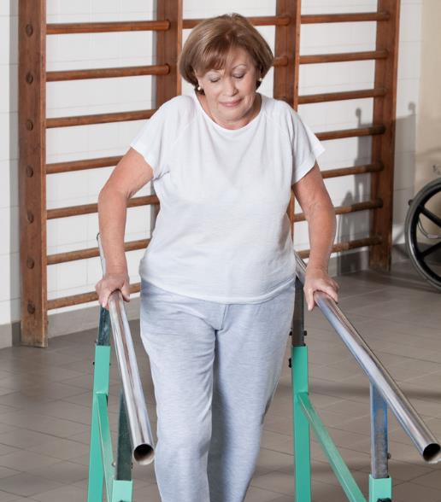
Specialized Rehabilitative Services
F 645 Preadmission Screening for Individuals with a mental disorder and individuals with intellectual disability
Specialized services
https://www.cms.gov/Regulations-and-Guidance/Guidance/Manuals/downloads/som107ap_pp_guidelines_ltcf.pdf
Notes:
§483.20(k) Preadmission Screening for individuals with a mental disorder and individuals with intellectual disability.
§483.20(k)(1) A nursing facility must not admit, on or after January 1, 1989, any new residents with:
(i) Mental disorder as defined in paragraph (k)(3)(i) of this section, unless the State mental health authority has determined, based on an independent physical and mental evaluation performed by a person or entity other than the State mental health authority, prior to admission,
(A) That, because of the physical and mental condition of the individual, the individual requires the level of services provided by a nursing facility; and
(B) If the individual requires such level of services, whether the individual requires specialized services; or
(ii) Intellectual disability, as defined in paragraph (k)(3)(ii) of this section, unless the State intellectual disability or developmental disability authority has determined prior to admission—
(A) That, because of the physical and mental condition of the individual, the individual requires the level of services provided by a nursing facility; and
(B) If the individual requires such level of services, whether the individual requires specialized services for intellectual disability.¹²
Review process to monitor outcomes for specialized rehab and resident maintaining or attaining functional outcomes per plan
Review process to addressing preferences and needs assessed by the MDS, the comprehensive care plan must coordinate with and address any specialized services or specialized rehabilitation services the facility will provide or arrange as a result of PASARR recommendations

Slide 19
Change of Condition Competency Is A MUST!
Notes:
A key component of overall clinical competency is a nurse’s (RN, LPN) or a CNA’s ability to identify and to address a resident’s Change of Condition. Facility staff should be aware of each resident’s current health status and regular activity. They should also be able to promptly identify changes that may indicate a change in health status.
Residents that are participating in Specialized rehab services and have a change of condition—all staff must be able to identify and communicate changes
Changes of Condition often result in trips to the hospital. These trips and stays can be physically and emotionally challenging for the residents.
There should always be excellent communication and collaboration between all members of the IDT

Slide 20
Specialized Rehabilitative Services
In situations where there are differences between federal and state supervision requirements, the requirement with the greater level of supervision will apply
Notes:
Speaker Notes:
Read the slide.

Slide 21
Infection Control
Hand Hygiene
Handling of Devices
Equipment
Environmental Surfaces
Transmission-Based Precautions
Notes:
Specialized Rehab personnel should be familiar with infection control procedures in the facility to include:
Hand Hygiene
Devices (such as indwelling catheters-care not to lift the bag over the level of the bladder, etc.)
Cleaning AND disinfecting equipment and environmental surfaces
What to do and how to protect (i.e. PPE) with resident on Transmission-Based Precautions

Slide 22
In Summary
Notes:
Summarize the overall training with the team.
Providing Specialized Rehabilitation is an instrumental services that is necessary in many instances to provide quality of care interventions that require qualified staff to perform, in order to attain resident’s highest level of functioning, prepare for discharge, assist in improving conditions and even pain management. The Federal Requirements of Participation outline who can perform and the requirements of evaluating the need based upon the Facility Assessment and upon a physician order. The IDT must communicate and work together with the assessment process, person-centered care planning to include resident input and continue to monitor resident for any changes of condition and outcome of therapy services. Thank you for participating in this class today.

Slide 24
References and Resources
Centers for Medicare & Medicaid Services State Operations Manual, Appendix PP – Guidance to Surveyors for Long Term Care Facilities (Rev. 173, 11-22-17): https://www.cms.gov/Regulations-and-Guidance/Guidance/Manuals/downloads/som107ap_pp_guidelines_ltcf.pdf
Centers for Medicare and Medicaid Services: Specialized Rehabilitative or Restorative Services Critical Element Pathway, Form CMS 20080 (5/2017): https://www.cms.gov/Medicare/Provider-Enrollment-and-Certification/GuidanceforLawsAndRegulations/Nursing-Homes.html
Manufacturer’s Recommendations on equipment, adaptive equipment, supplies, etc.

Slide 25
Disclaimer
“This presentation provided is copyrighted information of Pathway Health. Please note the presentation date on the title page in relation to the need to verify any new updates and resources that were listed in this presentation. This presentation is intended to be informational. The information does not constitute either legal or professional consultation. This presentation is not to be sold or reused without written authorization.”

