Slide 1

Hospice Integration Competency
Staff Training
Notes:
Welcome to the Hospice Services integration training for all staff.

Slide 2
Objectives
Upon completion of the program, attendees should be able to:
Verbalize the requirement for long term care facility when it chooses whether or not to arrange for hospice care in the facility
Understand the responsibilities of the nursing facility and the hospice
Describe the communication responsibilities when a resident has elected hospice services
Notes:
Read the objectives above

Slide 3

Notes:
Please see the State Operations Manual, Appendix PP for those requirements related to hospice integration and coordination for your process. This presentation will focus on successful discharge planning. F 849

Slide 4

F849 Hospice services.
A long-term care (LTC) facility may do either of the following:
Arrange for the provision of hospice services through an agreement with one or more Medicare-certified hospices.
Not arrange for the provision of hospice services at the facility through an agreement with a Medicare-certified hospice and assist the resident in transferring to a facility that will arrange for the provision of hospice services when a resident requests a transfer.
https://www.cms.gov/Regulations-and-Guidance/Guidance/Manuals/downloads/som107ap_pp_guidelines_ltcf.pdf
Notes:
Speaker Notes:
Read the slide.
If the resident chooses to elect the hospice benefit, but has not chosen a hospice provider, and the nursing home does not have an agreement with a hospice provider:
• If the resident wishes, the nursing home must assist the resident with a transfer to another facility or appropriate setting where hospice services are provided; or
• The nursing home may choose to establish a written agreement with a hospice.

Slide 5
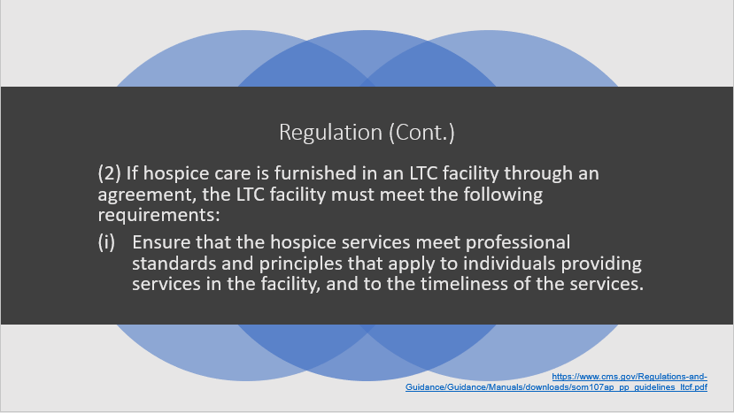
Notes:
Read slide

Slide 6
Regulation
(ii)Have a written agreement with the hospice that is signed by an authorized representative of the hospice and an authorized representative of the LTC facility before hospice care is furnished to any resident. The written agreement must set out at least the following:
The services the hospice will provide.
The hospice’s responsibilities for determining the appropriate hospice plan of care
The services the LTC facility will continue to provide based on each resident’s plan of care.
A communication process, including how the communication will be documented between the LTC facility and the hospice provider, to ensure that the needs of the resident are addressed and met 24 hours per day.
A provision that the LTC facility immediately notifies the hospice about the following:
A significant change in the resident’s physical, mental, social, or emotional status.
Clinical complications that suggest a need to alter the plan of care.
A need to transfer the resident from the facility for any condition.
The resident’s death.
https://www.cms.gov/Regulations-and-Guidance/Guidance/Manuals/downloads/som107ap_pp_guidelines_ltcf.pdf
Notes:
Indicate that you will be discussing the services the hospice and the nursing home are to provide in a later slide
The Hospice assumes responsibility for determining the appropriate course of hospice care, including the determination to change the level of services provided.

Slide 7

Regulation (Cont.)
A provision stating that the hospice assumes responsibility for determining the appropriate course of hospice care, including the determination to change the level of services provided.
An agreement that it is the LTC facility’s responsibility to furnish 24-hour room and board care, meet the resident’s personal care and nursing needs in coordination with the hospice representative
https://www.cms.gov/Regulations-and-Guidance/Guidance/Manuals/downloads/som107ap_pp_guidelines_ltcf.pdf
Notes:
Speaker Notes:
Read the slide.
and ensure that the level of care provided is appropriately based on the individual resident’s needs.
Also, (H) A delineation of the hospice’s responsibilities, including but not limited to, providing medical direction and management of the patient; nursing; counseling (including spiritual, dietary, and bereavement); social work; providing medical supplies, durable medical equipment, and drugs necessary for the palliation of pain and symptoms associated with the terminal illness and related conditions; and all other hospice services that are necessary for the care of the resident’s terminal illness and related conditions.
**NOTE: a resident should not experience any lack of services or personal care because they have chosen hospice!

Slide 8
Regulation (continued)
LTC facility personnel are responsible for the administration of prescribed therapies, including those therapies determined appropriate by the hospice and delineated in the hospice plan of care,
Input into the facility’s scope of services including the capacity to care for residents with complex or special care needs, such as dialysis, hospice or end-of-life care,…
https://www.cms.gov/Regulations-and-Guidance/Guidance/Manuals/downloads/som107ap_pp_guidelines_ltcf.pdf
Notes:
the LTC facility personnel may administer the therapies where permitted by State law and as specified by the LTC facility.
The hospice and the LTC facility will provide bereavement services to LTC facility staff.

Slide 9

Regulation (Cont.)
(3) Each LTC facility arranging for the provision of hospice care under a written agreement must designate a member of the facility’s interdisciplinary team who is responsible for working with hospice representatives to coordinate care to the resident provided by the LTC facility staff and hospice staff. The designated interdisciplinary team member is responsible for the following:
Collaborating with hospice representatives and coordinating LTC facility staff participation in the hospice care planning process for those residents receiving these services.
Communicating with hospice representatives and other healthcare providers participating in the provision of care for the terminal illness, related conditions, and other conditions, to ensure quality of care for the patient and family.
Ensuring that the LTC facility communicates with the hospice medical director, the patient’s attending physician, and other practitioners participating in the provision of care to the patient as needed to coordinate the hospice care with the medical care provided by other physicians.
https://www.cms.gov/Regulations-and-Guidance/Guidance/Manuals/downloads/som107ap_pp_guidelines_ltcf.pdf
Notes:
Speaker Notes:
The interdisciplinary team member must have a clinical background, function within their State scope of practice act, and have the ability to assess the resident or have access to someone that has the skills and capabilities to assess the resident.
This designated team member must also work with the Hospice for:
Obtaining the following information
(A) The most recent hospice plan of care specific to each patient.
(B) Hospice election form.
Physician certification and recertification of the terminal illness specific to each patient.
Names and contact information for hospice personnel involved in hospice care of each patient.
Instructions on how to access the hospice’s 24-hour on-call system.
Hospice medication information specific to each patient.
Hospice physician and attending physician (if any) orders specific to each patient.

Slide 10
Definitions
“Hospice care” -means a comprehensive set of services described in Section 1861(dd)(1) of the Social Security Act, identified and coordinated by an interdisciplinary group (IDG) to provide for the physical, psychosocial, spiritual, and emotional needs of a terminally ill patient and/or family members, as delineated in a specific patient plan of care
“Palliative care” - means patient and family-centered care that optimizes quality of life by anticipating, preventing, and treating suffering. Palliative care throughout the continuum of illness involves addressing physical, intellectual, emotional, social, and spiritual needs and to facilitate patient autonomy, access to information, and choice
https://www.cms.gov/Regulations-and-Guidance/Guidance/Manuals/downloads/som107ap_pp_guidelines_ltcf.pdf
Notes:
Speaker Notes:
Read the slide.

Slide 11

Definitions
“Terminally ill” - means that the individual has a medical prognosis that his or her life expectancy is 6 months or less if the illness runs its normal course.
“Bereavement counseling” - means emotional, psychosocial, and spiritual support and services provided before and after the death of the patient to assist with issues related to grief, loss, and adjustment
https://www.cms.gov/Regulations-and-Guidance/Guidance/Manuals/downloads/som107ap_pp_guidelines_ltcf.pdf
Notes:
Speaker Notes:
Read the slide.

Slide 12

Definitions
“Hospice Attending Physician” - This clarifies that a doctor of medicine, osteopathy or nurse practitioner, if meeting the listed requirements, may function as the “attending physician” in a hospice.
The hospice regulations do not provide for a physician assistant to function as the hospice attending physician.
https://www.cms.gov/Regulations-and-Guidance/Guidance/Manuals/downloads/som107ap_pp_guidelines_ltcf.pdf
Notes:
Speaker Notes:
Definitions. For the purposes of this part — “Attending physician” means a
(1) (i) Doctor of medicine or osteopathy legally authorized to practice medicine and surgery by the State in which he or she performs that function or action; or
(ii) Nurse practitioner who meets the training, education, and experience requirements as described in §410.75 (b) of this chapter.
(2) Is identified by the individual, at the time he or she elects to receive hospice care, as having the most significant role in the determination and delivery of the individual's medical care.

Slide 13

Collaboration Strategies
Respect the expertise of each entity
Acknowledgement of each other’s regulations
Define the communication process
Schedule routine meetings
Consistent staffing
Attendance at care plan meetings
Integrated Plan of Care
Notes:
Speaker Notes:
Read the slide.

Slide 14
Communication Nursing Home and Hospice
1. All staff (facility and Hospice) caring for resident need to be aware of the location of the advance directive in the record
2. All staff (facility and Hospice) caring for the resident should be involved in the communication process for directions for all current person-centered care plan goals and interventions consistent with resident’s identified choices/wishes
3. Nurses need to communicate resident’s identified needs, including advance directive wishes to practitioners with consideration of treatment plans
4. All changes in resident care plans will be immediately communicated to all who care for the resident – both facility and Hospice as well as being clearly documented according to facility and Hospice process
Notes:
Speaker Notes:
Read the slide.
The process for communicating necessary information regarding the resident’s care between the nursing home and the hospice must provided 24-hours a day, 7-days a week availability and how these communications will be documented.

Slide 15

Immediate Notification of Changes
The nursing home will immediately contact and communicate with the hospice staff regarding any significant changes in the resident’s status, clinical complications or emergent situations.
Notes:
Speaker Notes:
Read the slide/
Situations include, but are not limited to, changes in cognition or sudden unexpected decline in condition, a fall with a suspected fracture or adverse consequences related to a medication or therapy, or other situations requiring a revision to the plan of care.
The immediate notification to hospice does not change the requirement that a nursing home must also immediately notify the resident’s attending physician/practitioner.

Slide 16

Nursing Home Responsibilities for Personal Care and Nursing Needs in Coordination with Hospice
It is the nursing home’s responsibility to continue to furnish 24-hour room and board care, meeting the resident’s personal care and nursing needs.
Services provided must be consistent with the plan of care developed in coordination with the hospice Interdisciplinary Group (IDG).
Notes:
Speaker Notes:
Read the slide.
It is the nursing home’s responsibility to continue to furnish 24-hour room and board care, meeting the resident’s personal care and nursing needs. The facility’s services must be consistent with the care plan developed in coordination with the hospice, and the facility must offer the same services to its residents who have elected the hospice benefit as it furnishes to its residents who have not elected the hospice benefit. Therefore, the nursing home resident should not experience any lack of services or personal care because of his or her status as a hospice patient.

Slide 17

Coordinated Care Planning
The facility and Hospice must collaborate in the development of a coordinated care plan which includes, but is not limited to, the following:
Resident/representative choices regarding care;
The hospice philosophy of care and all services necessary for the palliation and management of the terminal illness and related conditions;
Measurable goals and interventions based on comprehensive and ongoing assessments;
Notes:
Speaker Notes:
Read the slide.
The intent is to ensure coordination of care between the nursing home and the hospice in order to assure that the most current plans of care for each resident have been coordinated, individualized and identify what each entity will provide.

Slide 18

Care Planning
Continued-
Resident/representative choices regarding care;
The hospice philosophy of care and all services necessary for the palliation and management of the terminal illness and related conditions;
Measurable goals and interventions based on comprehensive and ongoing assessments;
Notes:
Speaker Notes:
Read the slide.
Remember to take into consideration the resident’s/resident representative identified wishes for regarding care and treatment to be implemented when the resident is no longer able to communicate these wishes due to decline in condition. These wishes should be reflected on resident-centered plan of care.
In addition:
Interventions that address, as appropriate, the identification of timely, pertinent non-pharmacologic and pharmacological interventions to manage pain and other symptoms of discomfort;
The hospice portion that governs the actions of the hospice and describes the services that are needed to care for the resident;
Identification of the services the nursing home will continue to provide; and
The identification of the provider responsible for performing specific services/functions that have been agreed upon.

Slide 19
Facility Specific Care Plan Collaborative Protocol
Add Here

Slide 20
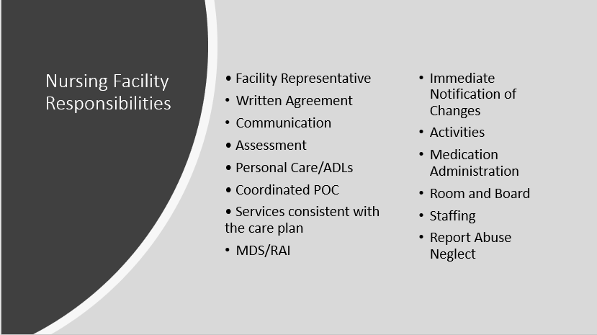
Nursing Facility Responsibilities
Notes:
Speaker Notes:
Read the slide.
Each LTC facility arranging for the provision of hospice care under a written agreement must designate a member of the facility’s interdisciplinary team who is responsible for working with hospice representatives to coordinate care to the resident provided by the LTC facility staff and hospice staff. The interdisciplinary team member must have a clinical background, function within their State scope of practice act, and have the ability to assess the resident or have access to someone that has the skills and capabilities to assess the resident. This person is usually the ADON or a Nurse Manager.

Slide 21

Hospice Responsibilities
Professional management
Written agreement
Communication
Determine course & level of care
Hospice care & services
Coordinated POC
Coordination of services
Orientation & training of nursing home staff
Bereavement services to nursing home staff
Notes:
Speaker Notes:
Read the slide.
The hospice care and services can include nurses, social services, clergy, volunteers, physicians, therapists and even CNA’s

Slide 22

Hospice Aides
Bathing
ADL Care
Assisting with Meals
Following the Coordinated Care Plan
Notes:
There may be some hospice residents who have a hospice aide come into the facility several days/week. Note: Even though the Hospice Aides are caring for the resident, the CNA is still responsible for the care on the care plan for the shift and should coordinate with the Hospice aide when they will leave to ensure seamless care!

Slide 23

Nurses Ongoing Responsibilities
Provide nursing care consistent with the care plan
Coordination with hospice
Medication Administration
Treatments
Symptom Management
Assessments
Follow up
Notes:
The nurse should also be aware of the resident choices, preferences, advance directives, etc.
Symptoms management (e.g., pain, nausea, vomiting, respiratory concerns, weakness, lethargy, vertigo, skin integrity issues including existing wounds, infections)
NOTE: The nurse should also tell the MDS Nurse anytime the resident either starts or stops Hospice because they will need to complete a Significant Change of Condition MDS Assessment

Slide 24

CNA Responsibilities
Provide nursing care consistent with the care plan
ADL Care
Observe for any pain or changes of condition
Resident specific interventions:
  Nutrition and fluids
  Oral Care
  Repositioning
  Non-medication interventions
  Vital signs
Notes:
All staff need to follow the care plan
Non medication interventions:
Repositioning
Massage
Music
Diversion (tv, activities, etc.)
Visits from family, friends, pets, etc.
NOTE: the CNA should always monitor for skin integrity—even for residents on Hospice! The resident may choose to refuse repositioning but when the CNA is caring for the resident, they should always observe and monitor skin for any skin integrity issues and report to the nurse

Slide 25
All Staff Responsibilities
Understand facility hospice policies and procedures
Understand your role related to residents receiving hospice care
Admissions team – discuss hospice services and coordination of services
Social Services – discuss hospice services and coordination of services
Most important – Person centered care
Notes:
Discuss with the team –

Slide 26

In Summary
Notes:
Summary - Add any facility specific information for the IDT.
The Nursing Home and Hospice should work together to coordinate services to meet the needs and choices/preferences of the resident for quality of care at end of life!

Slide 27


Slide 28
References and Resources
Centers for Medicare and Medicaid Services (CMS) State Operations Manual, Appendix PP-Guidance to Surveyors for Long Term Care Facilities. (Rev. 173, 11-22-17): https://www.cms.gov/Regulations-and-Guidance/Guidance/Manuals/downloads/som107ap_pp_guidelines_ltcf.pdf
Centers for Medicare and Medicaid Services, Hospice end of Life Critical Element Pathway. CMS 20073 (5/2017): https://www.cms.gov/Medicare/Provider-Enrollment-and-Certification/GuidanceforLawsAndRegulations/Nursing-Homes.html

Slide 29
Disclaimer
“This presentation provided is copyrighted information of Pathway Health. Please note the presentation date on the title page in relation to the need to verify any new updates and resources that were listed in this presentation. This presentation is intended to be informational. The information does not constitute either legal or professional consultation. This presentation is not to be sold or reused without written authorization.”

