Slide 1
Skin and Wound Care Competency
Staff Training
Notes:
Today’s presentation will address areas with skin integrity and pressure ulcer management competency.

Slide 2
Objectives
Upon completion of the program, attendees should be able to:
Verbalize understanding of the skin/pressure ulcer care program
Review the Federal Regulations
Describe the facility policies/procedures and protocols for prevention and management of wounds
Notes:
Read objectives

Slide 3
CMS: State Operations Manual
https://www.cms.gov/Regulations-and-Guidance/Guidance/Manuals/downloads/som107ap_pp_guidelines_ltcf.pdf
Notes:
We will start out talking about the new revised requirements for long term care facilities

Slide 4
F686: Skin Integrity
Pressure Ulcers: Based on the comprehensive assessment of a resident, the facility must ensure that—
(i) A resident receives care, consistent with professional standards of practice, to prevent pressure ulcers and does not develop pressure ulcers unless the individual’s clinical condition demonstrates that they were unavoidable; and
(ii) A resident with pressure ulcers receives necessary treatment and services, consistent with professional standards of practice, to promote healing, prevent infection and prevent new ulcers from developing.
https://www.cms.gov/Regulations-and-Guidance/Guidance/Manuals/downloads/som107ap_pp_guidelines_ltcf.pdf
Notes:
The requirements of participation discuss the importance of competency by clearly addressing care consistent with professional standards of practice

Slide 5
F686: Skin Integrity (continued)
INTENT: “The intent of this requirement is that the resident does not develop pressure ulcers/injuries (PU/PIs) unless clinically unavoidable and that the facility provides care and services consistent with professional standards of practice…”
https://www.cms.gov/Regulations-and-Guidance/Guidance/Manuals/downloads/som107ap_pp_guidelines_ltcf.pdf
Notes:
• Promote the prevention of pressure ulcer/injury development;
• Promote the healing of existing pressure ulcers/injuries (including prevention of infection to the extent possible); and
• Prevent development of additional pressure ulcer/injury.

Slide 6
F686: Skin Integrity (continued)
NOTE: CMS is aware of the array of terms used to describe alterations in skin integrity due to pressure. Some of these terms include:
Pressure ulcer,
Pressure injury,
Pressure sore,
Decubitus ulcer and
Bed sore.
https://www.cms.gov/Regulations-and-Guidance/Guidance/Manuals/downloads/som107ap_pp_guidelines_ltcf.pdf
Notes:
Clinicians may use and the medical record may reflect any of these terms, as long as the primary cause of the skin alteration is related to pressure”

Slide 7
F686: Skin Integrity Definitions
“Pressure Ulcer/Injury (PU/PI)” refers to localized damage to the skin and/or underlying soft tissue usually over a bony prominence or related to a medical or other device.
A pressure injury will present as intact skin and may be painful. A pressure ulcer will present as an open ulcer, the appearance of which will vary depending on the stage and may be painful.
https://www.cms.gov/Regulations-and-Guidance/Guidance/Manuals/downloads/som107ap_pp_guidelines_ltcf.pdf
Notes:
Definition of Pressure Ulcer/Injury—please note that the updated terminology now indicates “Pressure Injury”

Slide 8
F686: Skin Integrity Definitions
“Pressure Ulcer/Injury (PU/PI)” (Continued)
The injury occurs as a result of intense and/or prolonged pressure or pressure in combination with shear. The tolerance of soft tissue for pressure and shear may also be affected by skin temperature and moisture, nutrition, perfusion, co-morbidities and condition of the soft tissue.
https://www.cms.gov/Regulations-and-Guidance/Guidance/Manuals/downloads/som107ap_pp_guidelines_ltcf.pdf
Notes:
Definition of Pressure Ulcer/Injury—please note that the updated terminology now indicates “Pressure Injury”
Review with team members - relate to LN as well as CNAs

Slide 9
F686: Skin Integrity Definitions
“Avoidable” means that the resident developed a pressure ulcer/injury and that the facility did not do one or more of the following: evaluate the resident’s clinical condition and risk factors; define and implement interventions that are consistent with resident needs, resident goals, and professional standards of practice; monitor and evaluate the impact of the interventions; or revise the interventions as appropriate.
https://www.cms.gov/Regulations-and-Guidance/Guidance/Manuals/downloads/som107ap_pp_guidelines_ltcf.pdf
Notes:
Avoidable and Unavoidable is where both surveyors AND lawyers can address new skin integrity issues. Did you provide appropriate care AND did you document that care?

Slide 10
F686: Skin Integrity
“Unavoidable” means that the resident developed a pressure ulcer/injury even though the facility had evaluated the resident’s clinical condition and risk factors; defined and implemented interventions that are consistent with resident needs, goals, and professional standards of practice; monitored and evaluated the impact of the interventions; and revised the approaches as appropriate.
https://www.cms.gov/Regulations-and-Guidance/Guidance/Manuals/downloads/som107ap_pp_guidelines_ltcf.pdf

Slide 11
Notes:
Debridement methods may include a range of treatments such as the use of enzymatic dressings to surgical debridement in order to remove tissue or matter from a wound to promote healing.

Slide 12
F686: Skin Integrity
“Eschar” is dead or devitalized tissue that is hard or soft in texture; usually black, brown, or tan in color, and may appear scab-like. Necrotic tissue and eschar are usually firmly adherent to the base of the wound and often the sides/ edges of the wound.
“Slough” is non-viable yellow, tan, gray, green or brown tissue; usually moist, can be soft, stringy and mucinous in texture. Slough may be adherent to the base of the wound or present in clumps throughout the wound bed.
https://www.cms.gov/Regulations-and-Guidance/Guidance/Manuals/downloads/som107ap_pp_guidelines_ltcf.pdf

Slide 13
F686: Skin Integrity
“Exudate” is any fluid that has been forced out of the tissues or its capillaries because of inflammation or injury. It may contain serum, cellular debris, bacteria and leukocytes.
“Granulation tissue” is the pink-red moist tissue that fills an open wound, when it starts to heal. It contains new blood vessels, collagen, fibroblasts, and inflammatory cells.
https://www.cms.gov/Regulations-and-Guidance/Guidance/Manuals/downloads/som107ap_pp_guidelines_ltcf.pdf
Notes:
“Purulent exudate/drainage/discharge” is any product of inflammation that contains pus (e.g., leukocytes, bacteria, and liquefied necrotic debris).
“Serous drainage or exudate” is watery, clear, or slightly yellow/tan/pink fluid that has separated from the blood and presents as drainage.

Slide 14
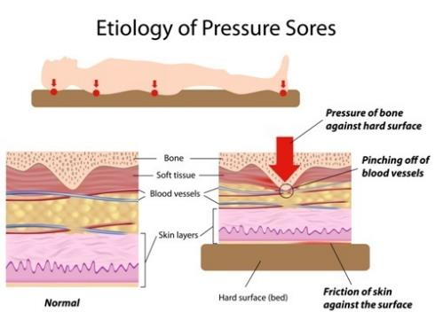
F686: Skin Integrity
“Friction” is the mechanical force exerted on skin that is dragged across any surface.
“Shearing” occurs when layers of skin rub against each other or when the skin remains stationary and the underlying tissue moves and stretches and angulates or tears the underlying capillaries and blood vessels causing tissue damage.
https://www.cms.gov/Regulations-and-Guidance/Guidance/Manuals/downloads/som107ap_pp_guidelines_ltcf.pdf
Notes:
This is why it is so important to appropriately position and care for the resident with skin that can be potentially fragile due to age, medications, circulation, moisture and more!

Slide 15
F686: Skin Integrity
A “tunnel” is a passageway of tissue destruction under the skin surface that has an opening at the skin level from the edge of the wound.
A “sinus tract” is a cavity or channel underlying a wound that involves an area larger than the visible surface of the wound.
“Undermining” is the destruction of tissue or ulceration extending under the skin edges (margins) so that the pressure ulcer is larger at its base than at the skin surface.”
https://www.cms.gov/Regulations-and-Guidance/Guidance/Manuals/downloads/som107ap_pp_guidelines_ltcf.pdf
Notes:
Undermining often develops from shearing forces and is differentiated from tunneling by the larger extent of the wound edge involved and the absence of a channel or tract extending from the pressure ulcer under the adjacent intact skin.

Slide 17
F686: Staging
“Stage 1 Pressure Injury: Non-blanchable erythema of intact skin Intact skin with a localized area of non-blanchable erythema (redness). In darker skin tones, the PI may appear with persistent red, blue, or purple hues. The presence of blanchable erythema or changes in sensation, temperature, or firmness may precede visual changes”
https://www.cms.gov/Regulations-and-Guidance/Guidance/Manuals/downloads/som107ap_pp_guidelines_ltcf.pdf
Notes:
STAGING of a PU/PI is performed to indicate the characteristics and extent of tissue injury, and should be conducted according to professional standards of practice.

Slide 18
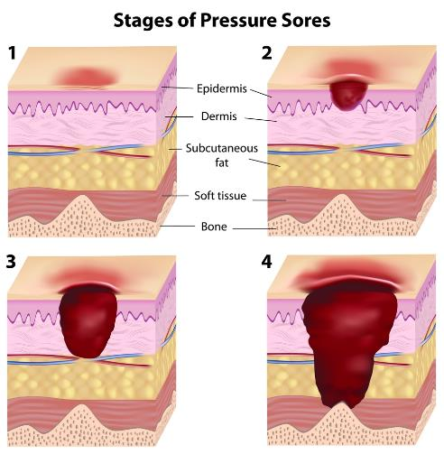
F686: Staging
“Stage 2 Pressure Ulcer: Partial-thickness skin loss with exposed dermis Partial-thickness loss of skin with exposed dermis, presenting as a shallow open ulcer. The wound bed is viable, pink or red, moist, and may also present as an intact or open/ruptured blister. Adipose (fat) is not visible and deeper tissues are not visible. Granulation tissue, slough and eschar are not present.”
https://www.cms.gov/Regulations-and-Guidance/Guidance/Manuals/downloads/som107ap_pp_guidelines_ltcf.pdf
Notes:
This stage should not be used to describe moisture associated skin damage including incontinence associated dermatitis, intertriginous dermatitis (inflammation of skin folds), medical adhesive related skin injury, or traumatic wounds (skin tears, burns, abrasions).

Slide 19
F686: Staging
“Stage 3 Pressure Ulcer: Full-thickness skin loss Full-thickness loss of skin, in which subcutaneous fat may be visible in the ulcer and granulation tissue and epibole (rolled wound edges) are often present. Slough and/or eschar may be visible but does not obscure the depth of tissue loss.”
Notes:
The depth of tissue damage varies by anatomical location; areas of significant adiposity can develop deep wounds. Undermining and tunneling may occur. Fascia, muscle, tendon, ligament, cartilage and/or bone are not exposed. If slough or eschar obscures the wound bed, it is an Unstageable PU/PI.

Slide 21
Notes:
Stable eschar (i.e. dry, adherent, intact without erythema or fluctuance) should only be removed after careful clinical consideration and consultation with the resident’s physician, or nurse practitioner, physician assistant, or clinical nurse specialist if allowable under state licensure laws. If the slough or eschar is removed, a Stage 3 or Stage 4 pressure ulcer will be revealed. If the anatomical depth of the tissue damage involved can be determined, then the reclassified stage should be assigned. The pressure ulcer does not have to be completely debrided or free of all slough or eschar for reclassification of stage to occur.

Slide 22
Notes:
These changes often precede skin color changes and discoloration may appear differently in darkly pigmented skin. This injury results from intense and/or prolonged pressure and shear forces at the bone-muscle interface. The wound may evolve rapidly to reveal the actual extent of tissue injury, or may resolve without tissue loss. If necrotic tissue, subcutaneous tissue, granulation tissue, fascia, muscle or other underlying structures are visible, this indicates a full thickness pressure ulcer. Once a deep tissue injury opens to an ulcer, reclassify the ulcer into the appropriate stage. Do not use DTPI to describe vascular, traumatic, neuropathic, or dermatologic conditions.

Slide 23
F686: Staging
“Medical Device Related Pressure Ulcer/Injury: Medical device related PU/PIs result from the use of devices designed and applied for diagnostic or therapeutic purposes. The resultant pressure injury generally conforms to the pattern or shape of the device. The injury should be staged using the staging system.
Mucosal Membrane Pressure Ulcer/Injury: Mucosal membrane PU/PIs are found on mucous membranes with a history of a medical device in use at the location of the injury. Due to the anatomy of the tissue, these ulcers cannot be staged.”
https://www.cms.gov/Regulations-and-Guidance/Guidance/Manuals/downloads/som107ap_pp_guidelines_ltcf.pdf
Notes:
When caring for residents, it is crucial to monitor for positioning of indwelling catheter tubing, oxygen tubing and more!

Slide 24
F686: Prevention
The facility must:
Identify whether the resident is at risk for developing or has a PU/PI upon admission and thereafter;
Evaluate resident specific risk factors and changes in the resident’s condition that may impact the development and/or healing of a PU/PI;
Implement, monitor and modify interventions to attempt to stabilize, reduce or remove underlying risk factors; and
If a PU/PI is present, provide treatment to heal it and prevent the development of additional PU/PIs.”
https://www.cms.gov/Regulations-and-Guidance/Guidance/Manuals/downloads/som107ap_pp_guidelines_ltcf.pdf
Notes:
The first step in the prevention of PU/PIs, is the identification of the resident at risk of developing PU/PIs. This is followed by implementation of appropriate individualized interventions and monitoring for the effectiveness of the interventions

Slide 25
Notes:
§ 483.25 Quality of care Quality of care is a fundamental principle that applies to all treatment and care provided to facility residents. Based on the comprehensive assessment of a resident, the facility must ensure that residents receive treatment and care in accordance with professional standards of practice, the comprehensive person-centered care plan, and the residents’ choices

Slide 26
F684: Quality of Care
Review of a Resident with Non Pressure-Related Skin Ulcer/Wound. Residents may develop various types of skin ulceration. At the time of the assessment and diagnosis of a skin ulcer/wound, the clinician is expected to document the clinical basis (e.g., underlying condition contributing to the ulceration, ulcer edges and wound bed, location, shape, condition of surrounding tissues) which permit differentiating the ulcer type, especially if the ulcer has characteristics consistent with a pressure ulcer, but is determined not to be one.
https://www.cms.gov/Regulations-and-Guidance/Guidance/Manuals/downloads/som107ap_pp_guidelines_ltcf.pdf
Notes:
All of the same requirements for best practice monitoring apply: weekly measuring, daily observations and with baths, notifications to physician and resident representatives if does not improve in expected timeframe or if deteriorates.

Slide 27
F684: Quality of Care
Arterial Ulcer
Usually result of arterial occlusive disease (non-pressure)
Causes tissue necrosis
May present with residents with peripheral vascular disease, or other
Usually painful
Occurs at distal portion of lower extremity (top of foot or outside edge of foot)
Wound bed usually dry, pale with little or no exudate
May have diminished or absent pedal pulses
Cool to touch
Delayed capillary refill
https://www.cms.gov/Regulations-and-Guidance/Guidance/Manuals/downloads/som107ap_pp_guidelines_ltcf.pdf

Slide 28
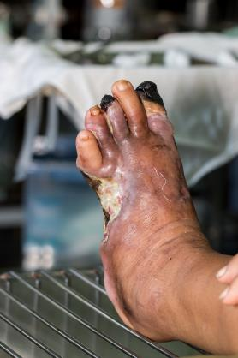
F684 Quality of Care
Diabetic Neuropathic Ulcer:
Requires diagnosis of diabetes mellitus with peripheral neuropathy
Mid foot, ball of foot over metatarsal head or top of toe
https://www.cms.gov/Regulations-and-Guidance/Guidance/Manuals/downloads/som107ap_pp_guidelines_ltcf.pdf

Slide 29
F684 Quality of Care
Venous or Stasis Ulcer:
Open lesion of the skin and subcutaneous tissue of the lower leg
Often most common vascular ulceration
May be difficult to heal
May occur after minor trauma
Moist, granulating wound bed
May be superficial
Minimal to copious serous drainage (unless infected
Resident may have pain that increases when foot is in dependent position

Slide 30
Policy and Procedures
Insert facility policy and procedures for skin prevention and wound management
Optional dependent upon State:
Review Tissue Tolerance requirements

Slide 31
Notes:
It is important for all staff to follow the individualized plan of care for the resident!

Slide 32
Notes:
It is crucial that you report ALL skin integrity concerns to the nurse-redness, bruising, rashes, open areas, etc. The documentation must be completed per facility policy

Slide 33
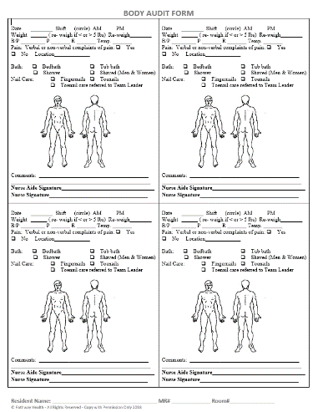
Body Audit Form (example shown here-please insert facility form)
Notes:
Describe staff responsibilities/facility policy for use of the Body Audit Form

Slide 34
Monitoring of Skin Integrity
Pressure Ulcer Weekly documentation should include:
Location
Stage
Dimensions
Undermining/tunneling
Wound based description
Drainage
Wound Edges
Odor
Pain
Progress
Notifications
Notes:
Review document, “Pressure Injury Documentation Guidelines” with nurses

Slide 35
Nutrition
The Dietician will be notified:
If a resident is considered nutritionally at risk
Upon the discovery of a wound
When a wound declines unexpectedly
If a wound is not showing progress in 2-4 weeks See Dietary Guidelines for Pressure Injuries
Notes:
The dietician will be involved when you have residents at high risk or with skin integrity concerns as their dietary needs may change. The dietician may order protein or other supplements for your resident. These must be encouraged as ordered by the physician and recommended by the dietician.

Slide 36
Therapy
Therapy
A Therapy evaluation will be requested for wheelchair seating, positioning, mobility, and / or pain management evaluation as appropriate.
Notes:
For residents that have concerns in their seating or if sliding out of chair, it will be helpful to work with the therapy department for an optimal resolution to seating concerns.

Slide 37
Treatment of Pressure Ulcers
Residents admitted with or with a new pressure injury or lower extremity ulcer:
Initiate the facility wound care guidelines
Notify practitioner
Notify supervisor
Notify dietary
Notify therapy as appropriate
Re-evaluate turning and repositioning schedule
Initiate Braden Scale* and Comprehensive Risk Data Collection Form
Re-evaluate interventions and update care plan
Notes:
1. (they must be a part of the signed standing orders) or Physicians order. The back of the Wound Care Guidelines, has space for the facility to write in the specific name brand products that are used.

Slide 38
Treatment of Pressure Ulcers
Residents admitted with or with a new pressure injury or lower extremity ulcer:
Update the CNA care cards per care plan changes
Initiate WEEKLY wound documentation progress sheets
Daily wound monitoring should include:
Evaluation of wound (with no dressing)
Evaluation of status of dressing (if dressing present)
Status of area surrounding the wound
Presence of any possible complications
Infection, increased drainage, pain, odor, etc.
Presence of pain
Notes:
The Weekly Wound Documentation Progress Sheet which will include: type of wound, location, date, stage (pressure injuries only) or indicate partial or full-thickness (arterial, venous, neuropathy/diabetic ulcers), length, width and depth; wound base description, wound edge description and if present: drainage, odor, undermining, tunneling, and/or pain. The Weekly Wound Documentation Progress Sheet should only have ONE WOUND per form. See Weekly Wound Documentation Progress Sheet & Wound Documentation Guidelines for instructions. Please note, only pressure injuries and lower extremity ulcers from arterial, venous or peripheral neuropathy/diabetes should be on this form. All other skin concerns should be documented on the Other Skin Conditions form.

Slide 39
Treatment of Pressure Ulcers
Residents admitted with or with a new pressure injury or lower extremity ulcer:
Document changes or concerns in the nurses notes
Notify practitioner, resident representative and supervisor if wound does not show progress in 2-4 weeks and/or deteriorating unexpectedly
Re-evaluate plan of care as indicated
Notes:
Ensure that you have compliance with a comprehensive body audit upon admission to identify wounds or any skin integrity concerns upon admission as they may not always be present in the documentational

Slide 40
Treatment of Pressure Ulcers
Resident Choice:
In order for a resident to exercise his or her right to appropriately make informed choices about care and treatment or to refuse treatment, the facility and the resident (or the resident’s legal representative) will discuss the resident’s condition, treatment options, expected outcomes, and consequences of refusing treatment.
Notes:
The facility will address the resident’s concerns and offer relevant alternatives if the resident has refused treatments/interventions. This will be documented in the resident’s medical record or (fill in location). Available in the Forms section is a Refusal of Skin Care Interventions Risk and Benefit Policy and Procedure and a Refusal of Skin Care Interventions Risk and Benefit Form that can be utilized for refusal of care

Slide 41
Notes:
This is an example of items that should be included with all orders.

Slide 42
In Summary
Notes:
We - as a team can provide a good, solid skin care prevention and wound care management in the facility to prevent negative outcomes for the residents we care for!

Slide 44
References and Resources
Centers for Medicare & Medicaid Services State Operations Manual, Appendix PP – Guidance to Surveyors for Long Term Care Facilities (Rev. 173, 11-22-17): https://www.cms.gov/Regulations-and-Guidance/Guidance/Manuals/downloads/som107ap_pp_guidelines_ltcf.pdf
LTC Survey Pathways (Download) https://www.cms.gov/medicare/provider-enrollment-and-certification/guidanceforlawsandregulations/nursing-homes.html

Slide 45
References and Resources
Centers for Medicare & Medicaid Services Long-Term Care Facility Resident Assessment Instrument 3.0 User’s Manual, Version 1.16. October 2018: https://www.cms.gov/Medicare/Quality-Initiatives-Patient-Assessment-Instruments/NursingHomeQualityInits/MDS30RAIManual.html

Slide 46
Disclaimer
“This presentation provided is copyrighted information of Pathway Health. Please note the presentation date on the title page in relation to the need to verify any new updates and resources that were listed in this presentation. This presentation is intended to be informational. The information does not constitute either legal or professional consultation. This presentation is not to be sold or reused without written authorization.”

