Slide 1
Nutrition: Diet and Food Textures Competency
CNA Staff Training
Notes:
Hello and Welcome to the program on Diet and Food Textures. Facilities will need to ensure that they have a robust food and nutrition program that outlines a program to ensure safe and individualized diet textures, in order to keep residents at their highest level of functioning while providing satisfaction with a diet that promotes safe nutrition and satisfaction for both quality of care and regulatory requirements. Your understanding of the program will assist with quality and compliance.

Slide 2
Objectives
Upon completion of the program, attendees should be able to:
Verbalize understanding of the regulations as they relate to diet and food textures
Understand the importance of following the plan of care when providing the resident with the proper diet/food texture
Describe the importance of good communication with the interdisciplinary team on resident specific diet needs or concerns
Notes:
Read the objectives above

Slide 3
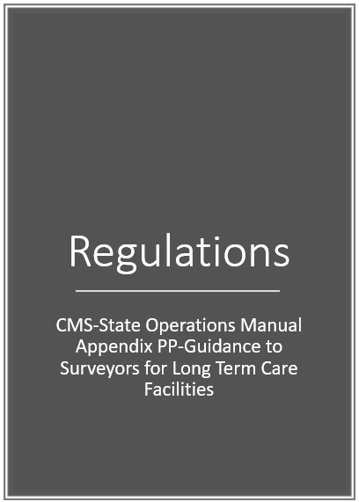
Regulations
CMS-State Operations Manual Appendix PP-Guidance to Surveyors for Long Term Care Facilities
https://www.cms.gov/Regulations-and-Guidance/Guidance/Manuals/downloads/som107ap_pp_guidelines_ltcf.pdf
Notes:
The Requirements of Participation include the Federal regulations that Long Term Care Facilities must comply with. We will talk about the specific regulations that revolve around dining assistance and adaptive equipment today

Slide 4
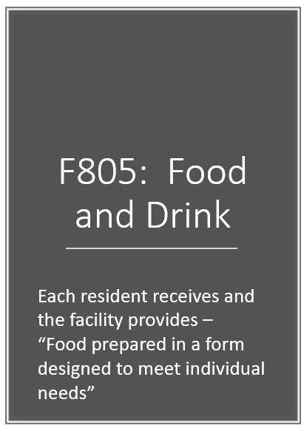
F805: Food and Drink
Each resident receives and the facility provides –
“Food prepared in a form designed to meet individual needs”
https://www.cms.gov/Regulations-and-Guidance/Guidance/Manuals/downloads/som107ap_pp_guidelines_ltcf.pdf
Notes:
For individual quality of care, it is ESSENTIAL that all residents receive the proper diet texture in accordance with their specific needs. This will also be observed during survey.
Surveyors will:
• Observe meals and food preparation to assure the food is prepared and appropriate to meet resident’s needs and according to their assessment and care plan.
• Are there any observations of residents having difficulty chewing or swallowing their food?
• Is the food texture appropriate for individual resident’s needs?

Slide 5
F806: Food and Drink
Offering substitutes
Food Textures
Allergies
Intolerances
Preferences
https://www.cms.gov/Regulations-and-Guidance/Guidance/Manuals/downloads/som107ap_pp_guidelines_ltcf.pdf
Notes:
Surveyors will:
• Ask residents how the food meets their preferences, allergies and/or intolerances.
• If residents who refuse food or drinks, ask them if they are offered substitutes.
• Interview residents or staff to determine how alternate food choices are communicated to the residents?
• How are food textures, allergies, intolerances, and preferences accommodated per a resident’s assessment, care plan and choice and how is this information communicated to staff?

Slide 6
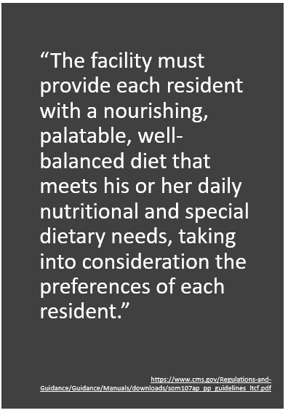
F800: Provided Diet Meets the Needs of Each Resident
“The facility must provide each resident with a nourishing, palatable, well-balanced diet that meets his or her daily nutritional and special dietary needs, taking into consideration the preferences of each resident.”
https://www.cms.gov/Regulations-and-Guidance/Guidance/Manuals/downloads/som107ap_pp_guidelines_ltcf.pdf
Notes:
“INTENT §483.60 - To ensure that facility staff support the nutritional well-being of the residents while respecting an individual’s right to make choices about his or her diet”

Slide 7
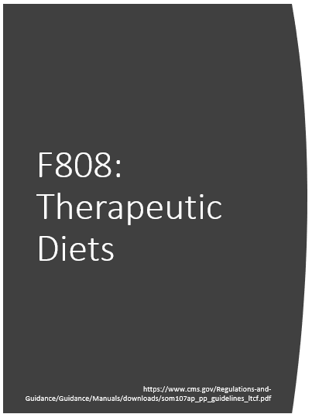
F808: Therapeutic Diets
Prescribed by the physician
INTENT: “To assure that residents receive and consume foods in the appropriate form and/or the appropriate nutritive content as prescribed by a physician, and/or assessed by the interdisciplinary team to support the resident’s treatment, plan of care, in accordance with his her goals and preferences.”
https://www.cms.gov/Regulations-and-Guidance/Guidance/Manuals/downloads/som107ap_pp_guidelines_ltcf.pdf
Notes:
The physician can delegate to a registered or licensed dietitian the task of prescribing a resident’s diet if allowed by State law.

Slide 8
Definitions
“Therapeutic Diet” means a diet ordered by a physician or delegated registered or licensed dietitian as part of treatment for a disease or clinical condition, or to eliminate or decrease specific nutrients in the diet, (e.g., sodium) or to increase specific nutrients in the diet (e.g., potassium), or to provide food the resident is able to eat (e.g., a mechanically altered diet).
“Mechanically altered diet” means one in which the texture of a diet is altered. When the texture is modified, the type of texture modification must be specific and part of the physicians’ or delegated registered or licensed dietitian order.
https://www.cms.gov/Regulations-and-Guidance/Guidance/Manuals/downloads/som107ap_pp_guidelines_ltcf.pdf
Notes:
These definitions are taken right out of the CMS State Operations Manual. Today we are focused on diet texture competencies.

Slide 9
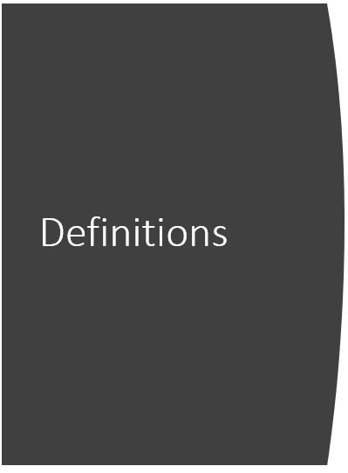
Definitions
A “Nourishing snack” means items from the basic food groups, either singly or in combination with each other.
“Suitable and nourishing alternative meals and snacks” means that when an alternate meal or snack is provided, it is of similar nutritive value as the meal or snack offered at the normally scheduled time and consistent with the resident plan of care.
https://www.cms.gov/Regulations-and-Guidance/Guidance/Manuals/downloads/som107ap_pp_guidelines_ltcf.pdf
Notes:
Facility staff must ensure meals and snacks are served at times in accordance with resident’s needs, preferences, and requests. Suitable and nourishing alternative meals and snacks must be provided for residents who want to eat at non-traditional times or outside of scheduled meal times. Adequacy of the “nourishing snack” will be determined both by resident interviews and by evaluation of the overall nutritional status of residents in the facility
**The facility is not required to provide a 24-hour a day full service dietary department but facilities do need to have a process to serve residents food/snacks at non-traditional times if necessary, including a bedtime snack. These snacks must be consistent with the resident’s diet and diet texture.

Slide 10
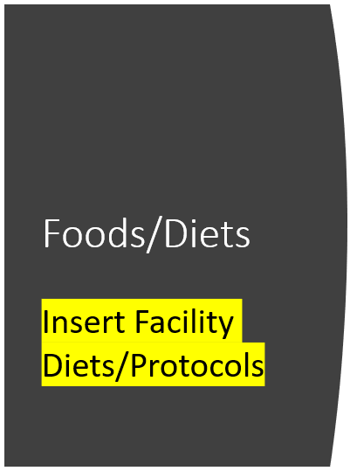
Foods/Diets
Regular
Easy to Chew
Soft & Bite-Sized
Minced & Moist
Pureed
Liquidised
https://iddsi.org/
Notes:
Please insert facility diets and descriptions

Slide 11
Thickened Liquids
INSERT HERE: Facility policy and procedure
Pre-thickened Liquids
Thickening Agents
ALWAYS follow manufacturer’s directions
ALWAYS follow the diet order for thickened liquids
Activities
Snacks/Nourishments
Notes:
INSERT HERE: Facility policy and procedure (Discuss who will thicken, how liquids will be prepared/sent to units, etc.)
Thickened liquids are for people who have difficulty swallowing liquids as they may run down into a resident’s lungs putting them at risk for aspiration and pneumonia. Many times, thickened liquids will help prevent this by giving the resident more control over the liquids (as they are thicker) that will hopefully result in a more controlled swallowing.

Slide 12
Safety
Diet Order
Person-Centered Care Plan
Diet Communication
Special Instructions
Snacks
Adaptive Equipment
CPR Certified Staff
Notes:
Diet Order: Be sure you have a diet order that is appropriate for the resident. If there are any questions or concerns—bring them up immediately in order to resolve any concerns
Person-Centered Care Plan: Each care plan should be based upon the individualized needs of the resident. Any swallowing interventions should be specific and outlined for care
Diet Communication: Communication on specific interventions, changes or needs should be immediate and meaningful to ensure proper care and services
Special Instructions: Any special instructions (for example, speech therapy recommendations for swallowing) should be clear and concise for both meals and snacks
Snacks: For activities and others providing in-between meal snacks, ALL staff must be aware of any residents requiring any special diet, swallowing interventions or adaptive equipment (including any thickened liquids needed). It may be necessary to have a CNA assist with activity snacks with residents that have specific swallowing needs
Adaptive Equipment: Should be available and clean whenever the resident needs them
CPR Certified Staff: Available at all times!

Slide 13
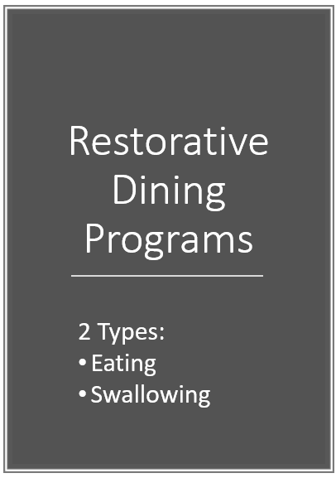
Notes:
2 Types:
Eating: Based upon assessed need: working with a resident on becoming more independent with getting the food/liquids to their mouth
Swallowing: Based upon assessment and identified swallowing deficit using interventions that are specific to that particular resident, for safe swallow (some of those interventions can include: diet texture, size of the bite, double swallow, chin tuck, alternate solids with liquids, thickened liquids, etc.)

Slide 14
Notes:
Discuss facility system to ensure all diets (including changes) are immediately updated for all departments (including activities for snacks)

Slide 15
Dietary Competencies
Describes preparation for: Food Textures/Diets
Preparation of Nourishments
Preparation of Thickened Liquids
New Admissions
Changes in Physician Orders
Offering Substitutes
Notes:
All Dietary staff must be aware of the facility policies and procedures for diet textures and preparation. Describe the process for offering substitutes that are consistent with the resident’s diet textures

Slide 16
CNA Competencies
Correct Diet and Diet Texture
Following Care Plan Interventions
Identifying and Reporting Changes in Condition
Thickened Liquids
Resident Positioning
Restorative Programs for Eating and/or Swallowing
Notes:
Correct Diet and Diet Texture: Discuss where to find changes and new admission information. Discuss the importance to check everyday for any changes
Following Care Plan Interventions: Specific swallowing directions will be located in the plan of care and the staff must follow as they are individualized to the needs of each resident
Identifying and Reporting Changes in Condition: If resident has difficulties with swallowing current diet or if the resident requests a change in diet, notify the nurse
Thickened Liquids: ALWAYS follow the instructions on the product and all staff must be trained in thickening liquids
Resident Positioning: Providing proper positioning of a resident is essential for safe eating. A resident should be sitting upright as much as possible.
Restorative Programs for Eating and/or Swallowing: When residents are designated for restorative eating or swallowing programs, the CNA’s or RA’s must following the directions as indicated on the restorative plan of care. Residents who can be candidates for a restorative eating program can be those who are discharged form therapy with a request for a program by the speech therapist OR:
Residents with swallowing problems.
Residents with poor oral strength.
Residents with weight loss and loss of upper extremity strength and range of motion.
Residents with decreased postural strength or loss of endurance while sitting

Slide 17
Residents Eating in Room
Safety
Supervision
Assistance Needs
Notes:
Safety: Is it safe to eat in bed? What about positioning?
Supervision: Discuss facility protocol for resident supervision in room. Encourage residents to eat in dining room whenever possible
Assistance Needs: Are you following the plan of care? Discuss

Slide 18
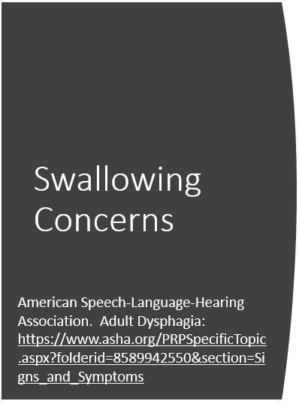
Swallowing Concerns
Coughing
Refusal to eat certain consistencies
Drooling
Increased secretions
Sneezing
Resident states it is hard to swallow
Pain or discomfort with swallowing
Voice changes
And more!
Notes:
Even residents who have repeated diagnosis of pneumonia of unknown origin can indicate swallowing concerns. If you identify these—notify the nurse right away! These would be indictors for a Speech Therapy evaluation

Slide 19
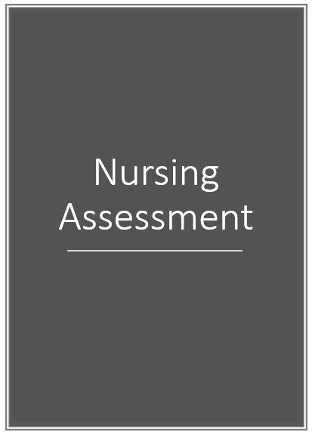
Notes:
If the resident has an episode of choking or swallowing difficulty, be sure to assess the resident, including a good head-toe with lung assessment prior to calling the doctor

Slide 20
Surveyors Observations
Proper diet
Resident preferences
Dining Assistance
Adaptive Equipment
Resident Positioning
Sound, lighting, temperatures
Infection Control
Care plan interventions
Notes:
During the survey, surveyors will be checking the dining rooms for all of the items listed. They will also monitor if the documentation on food and fluid intake is consistent with their observations.
Infection control includes both staff observations as well as staff assisting the resident with hand hygiene.
The surveyor will also ask about nourishments and snacks, including bedtime snack (Discuss facility protocols for bedtime snacks)

Slide 21
In Summary
Notes:
Summarize the overall training with the team.
In summary, facilities are required to provide a diet that is consistent with the resident’s needs-meaning BOTH nutritionally and in regards to the identified diet texture. The entire interdisciplinary team must be aware of the facility policies and procedures, importance of following the individualized plan of care, assistance necessary and competency in providing services to keep resident safe and at their highest level of functioning. Thank you for attending this session.

Slide 23
References and Resources
Centers for Medicare & Medicaid Services State Operations Manual, Appendix PP – Guidance to Surveyors for Long Term Care Facilities (Rev. 173, 11-22-17): https://www.cms.gov/Regulations-and-Guidance/Guidance/Manuals/downloads/som107ap_pp_guidelines_ltcf.pdf
LTC Survey Pathways (Download) https://www.cms.gov/medicare/provider-enrollment-and-certification/guidanceforlawsandregulations/nursing-homes.html
American Speech-Language-Hearing Association. Adult Dysphagia: https://www.asha.org/PRPSpecificTopic.aspx?folderid=8589942550&section=Signs_and_Symptoms
International Dysphagia Diet Standardisation Initiative: https://iddsi.org/

Slide 24
Disclaimer
“This presentation provided is copyrighted information of Pathway Health. Please note the presentation date on the title page in relation to the need to verify any new updates and resources that were listed in this presentation. This presentation is intended to be informational. The information does not constitute either legal or professional consultation. This presentation is not to be sold or reused without written authorization.”

