Slide 1
Identify and Report Resident Changes Competency
Direct Care Staff Training
Notes:
Welcome to the training on Identifying and reporting of changes of condition. Your role is key to this process and will assist in the overall assessment of the resident when there is a change.

Slide 2
Objectives
Upon completion of the program, attendees should be able to:
Verbalize their Role in early detection of resident changes?
Identify how identification of changes of condition early will promote quality care?

Slide 3
Key Points
Early recognition of changes
Communication across caregivers
Earlier assessment and intervention in the SNF facility
Quality of care
Notes:
Becoming familiar with your residents in order to recognize changes-even subtle changes- early will be instrumental in quality of care.
Many times when there is a subtle change, if the nurse evaluates that change and puts interventions in place or updates the doctor for orders, can help prevent deterioration of the resident condition—therefore COMMUNICATION will be essential

Slide 4
Is the resident different than usual ?
What does that mean?
Notes:
Have them give you examples?

Slide 5
Mood
Prefers to be alone or much more outgoing. Sleeps a lot more or a lot less. Seems to have no energy or has too much energy. Tells you they feel down or sad or worthless.
Other symptoms?
Notes:
Have you identified a change in the resident mood? Are they staying in their room, refusing meals or activities, in bed more than usual OR are they more talkative and energetic. These need to be reported to the nurse

Slide 6
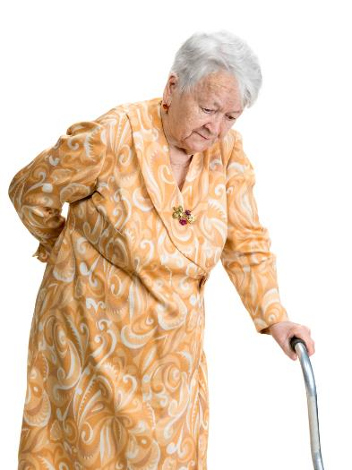
Functional Changes:
Transfer
Bed Mobility
Walking
Dressing
Grooming
Hygiene
Eating
Other areas?
Notes:
Functional changes:
Dressing, Grooming, Assistance with Meals, Bed Mobility, even subtle changes—was able to use the remote control to turn on the tv and cannot any longer, etc.

Slide 7
Unable to stay awake, does not know location, does not remember what you say
Other symptoms?
Consciousness or Memory
Notes:
Discuss with the class

Slide 8
Appetite or Intake
Eats or drinks less than or more than usual
Notes:
Group discussion of examples

Slide 9
Change in color, temperature, texture, an open area, discomfort
Other symptoms?
Skin Changes
Notes:
Pale? Lips and nailbeds blue? Yellow hue, etc.?

Slide 10
Other Symptoms that may mean a chronic condition is getting worse
Shoes or socks are tight
Resident is more tired than usual
A cough or shortness of breath when moving (when there was none before)
Resident complains of dizziness when up
Pain (chest, joints, headaches, arm)
Nausea or vomiting
Changes in urine
Notes:
Discuss examples -

Slide 12
Report Changes to the Nurse!
Report all changes
The nurse can assess the resident
The doctor can be notified and start treatment before the resident becomes too ill
Notes:
What is the process?
Who do you report changes to?

Slide 13
Facility Policy for Identification and Reporting
Notes:
Discuss roles and responsibilities related to reporting and identifying change of condition. INTERACT? Other process. Have staff verbalize what they would do if they identified a condition change.

Slide 14
In Summary
Notes:
Summarize the overall training with the team. Discuss roles and responsibilities related to reporting and identifying change of condition.

Slide 16
References and Resources
Centers for Medicare & Medicaid Services State Operations Manual, Appendix PP – Guidance to Surveyors for Long Term Care Facilities (Rev. 173, 11-22-17): https://www.cms.gov/Regulations-and-Guidance/Guidance/Manuals/downloads/som107ap_pp_guidelines_ltcf.pdf
LTC Survey Pathways (Download) https://www.cms.gov/medicare/provider-enrollment-and-certification/guidanceforlawsandregulations/nursing-homes.html
Centers for Medicare & Medicaid Services Long-Term Care Facility Resident Assessment Instrument 3.0 User’s Manual, Version 1.16. October 2018: https://www.cms.gov/Medicare/Quality-Initiatives-Patient-Assessment-Instruments/NursingHomeQualityInits/MDS30RAIManual.html

Slide 17
Disclaimer
“This presentation provided is copyrighted information of Pathway Health. Please note the presentation date on the title page in relation to the need to verify any new updates and resources that were listed in this presentation. This presentation is intended to be informational. The information does not constitute either legal or professional consultation. This presentation is not to be sold or reused without written authorization.”

