Slide 1
Respiratory Care (Airway and Tracheostomy) Competency
Nursing Staff Training
Notes:
Welcome the staff to the presentation

Slide 2
Objectives
Upon completion of the program, attendees should be able to:
Provide residents who require respiratory care receive such services, consistent with professional standards of practice
Recognize when the resident is experiencing respiratory distress
Evaluates existing respiratory distress and the cause(s)
Describes policies and procedures for respiratory care and services
Notes:
Read the objectives above

Slide 3
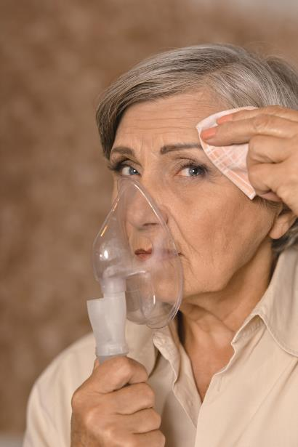
Respiratory Care-Airway and Trach
Assure a resident who requires or receives respiratory care services receives proper treatment and care. This may include:
respiratory treatments/therapy,
oxygen therapy,
the use of BiPAP/CPAP, tracheostomy and/or suctioning,
IPPB,
some centers may provide chest tubes and or mechanical ventilation)
https://www.cms.gov/Regulations-and-Guidance/Guidance/Manuals/downloads/som107ap_pp_guidelines_ltcf.pdf
Notes:
Speaker Notes:
Read the slide
The Federal Regulations require that facilities provide respiratory and trach care consistent with best practices and assessed needs.

Slide 4
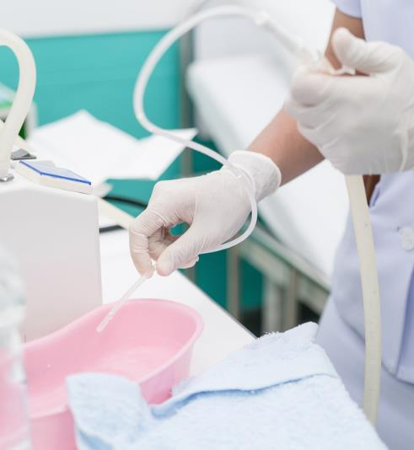
Respiratory Care-Airway and Trach
F695
Respiratory care, including tracheostomy care and tracheal suctioning.
“The facility must ensure that a resident who needs respiratory care, including tracheostomy care and tracheal suctioning, is provided such care, consistent with professional standards of practice, the comprehensive person-centered care plan, the residents’ goals and preferences”
https://www.cms.gov/Regulations-and-Guidance/Guidance/Manuals/downloads/som107ap_pp_guidelines_ltcf.pdf
Notes:
Speaker Notes:
Read the slide
INTENT §483.25 (i) The intent of this provision is that each resident receives necessary respiratory care and services that is in accordance with professional standards of practice, the resident’s care plan, and the resident’s choice.

Slide 5
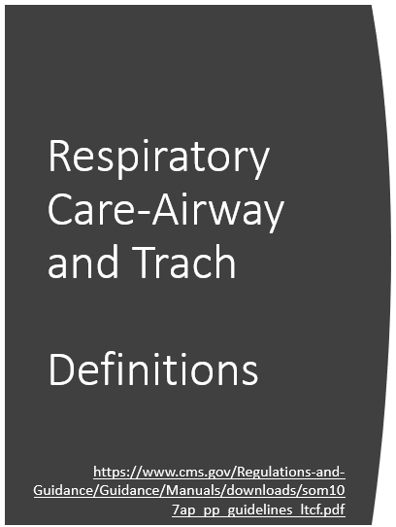
“Automatic self-adjusting positive airway pressure (APAP)”. APAP is a non-invasive ventilation machine that automatically adjusts the air pressure according to the patient's requirement at a particular time.
“Bi-level positive airway pressure (BiPAP)”. BiPAP is a non-invasive ventilation machine that is capable of generating two adjustable pressure levels - Inspiratory Positive Airway Pressure (IPAP) - high amount of pressure, applied when the patient inhales and a low Expiratory Positive Airway Pressure (EPAP) during exhalation.
“Continuous positive airway pressure (CPAP)”. CPAP is a non-invasive ventilation machine that involves the administration of air usually through the nose by an external device at a predetermined level of pressure.
Notes:
Speaker Notes
Read the slide

Slide 6
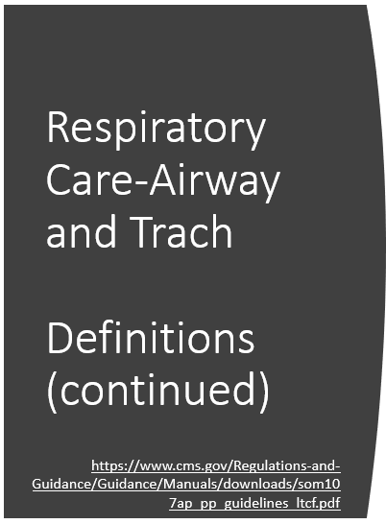
“Intermittent positive pressure breathing (IPPB)” is a technique used to provide short term or intermittent mechanical ventilation for the purpose of augmenting lung expansion, delivering aerosol medication, or assisting ventilation and can include pressure- and time-limited as well as pressure, time, and flow-cycled ventilation, and may be delivered to artificial airways and non-intubated patients.
“Mechanical Ventilation” may be defined as a life support system designed to replace or support normal ventilatory lung function.1
“Noninvasive ventilation (NIV)” refers to the administration of ventilatory support without using an invasive artificial airway (endotracheal tube or tracheostomy tube).
Notes:
Speaker Notes
Read the slide

Slide 7
Respiratory Care-Airway and Trach Definitions (continued)
“Obstructive Sleep Apnea (OSA” refers to apnea syndromes due primarily to collapse of the upper airway during sleep.
“Oxygen therapy” is the administration of oxygen at concentrations greater than that in ambient air (20.9%) with the intent of treating or preventing the symptoms and manifestations of hypoxia.
“Respiratory Therapy Service” are-services that are provided by a qualified professional (respiratory therapists, respiratory nurse) for the assessment, treatment, and monitoring of residents with deficiencies or abnormalities of pulmonary function (See §483.65, Specialized Rehabilitative Services).
“Ventilator Assisted Individual (VAI)” requires mechanical aid for breathing to augment or replace spontaneous ventilatory efforts to achieve medical stability or maintain life. a life support system designed to replace or support normal ventilatory lung function.
https://www.cms.gov/Regulations-and-Guidance/Guidance/Manuals/downloads/som107ap_pp_guidelines_ltcf.pdf
Notes:
Speaker Notes:
Read the slide.

Slide 8
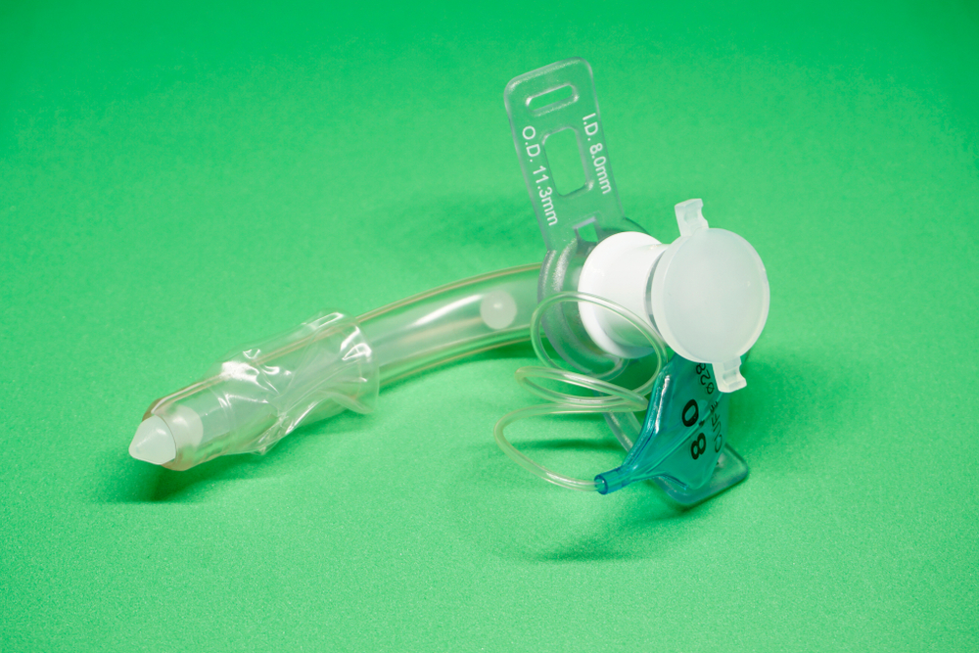
Respiratory Care-Airway and Trach
“Tracheotomy or Tracheostomy” is an opening surgically created through the neck into the trachea (windpipe) to allow direct access to the breathing tube and is commonly done in an operating room under general anesthesia. A tube is usually placed through this opening to provide an airway and to remove secretions from the lungs.
https://www.cms.gov/Regulations-and-Guidance/Guidance/Manuals/downloads/som107ap_pp_guidelines_ltcf.pdf
Notes:
The term “tracheotomy” refers to the incision into the trachea (windpipe) that forms a temporary or permanent opening, which is called a “tracheostomy,” however the terms are sometimes used interchangeably. Breathing is done through the tracheostomy tube rather than through the nose and mouth.

Slide 9
Respiratory Care-Airway and Trach
Systems for Respiratory Services/Care
Policies and Procedures
Assessments
Documentation Review
Education (staff, resident, family, practitioners)
Care Plan Implementation
Auditing
Review of Quality Measures
Quality Assurance
Notes:
Speaker Notes
Read the slide

Slide 10
Respiratory Care-Airway and Trach
Respiratory Assessment and Monitoring
Vital Signs
Abnormal breath/lung sounds (crackles, rhonchi, noisy respirations)
Dyspnea
Cough (ineffective, with or without sputum)
Increased breathing effort (nasal flaring, intercostal retractions, use of accessory muscles, pursed-lip breathing or prolonged expiratory phase)
Shortness of breath
Tachypnea and/or changes in breathing pattern
Decreased Po2 and Sao2; increased Pco2
Cyanosis
Tachypnea/bradypnea or cessation of respirations when off the ventilator
Notes:
Speaker Notes:
A respiratory assessment should include, but is not limited to: Read the slide
Other items to consider on Assessment:
Review of Diagnoses- Acute and Chronic concerns
Resident History of resolution-previous respiratory needs/treatment (What works? What hasn’t worked?)
Resident Interview- Is resident verbalizing pain? If new admission, were they medicated prior to leaving the hospital?
At a minimum, vital signs for Shortness of breath include:
Temperature,
BP, pulse, apical HR (if pulse irregular)
Respirations, Oxygen saturation and
Finger stick glucose (diabetics)
Always follow your facility policy and procedure for respiratory assessment and monitoring.

Slide 11
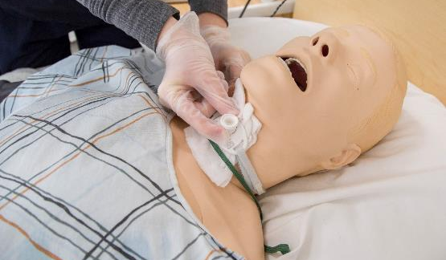
Competent Staff
You will need to be trained in best practices on care of the resident with respiratory needs, tracheostomy or ventilators if you provide that care in the facility. You will also be asked to show evidence of a return demonstration.
Notes:
Based upon its facility assessment, the resident population, diagnosis, staffing, resources and staff skills/knowledge, the facility must determine whether it has the capability and capacity to provide the needed respiratory care/services for a resident with a respiratory diagnosis or syndrome that requires specialized respiratory care and/or services.

Slide 12
Competency
Notes:
Disease State
Pharmacology
Assessment process
Example: Competency for Lung Sounds:
Gather equipment: stethoscope, alcohol pad
Identify resident
Hand Hygiene
Explain Procedure
Wipe stethoscope with alcohol wipe
Have the resident/client sit up, lean forward, and cross arms in front of chest. (If patient is unable to sit up, turn patient from side to side to auscultate the posterior lung fields.)
Use stethoscope to listen to lungs as patient breathes with mouth open. Listen to at least one full breath in each location.
Demonstrate location for lung sounds beginning above the clavicle the moving side to side and down. Include the 6th and 7the intercostal spaces where the lung bases are located.
Verbalizes understanding of normal lung sounds, irregular lung/breath sounds
Identifies when a resident needs to be reassessed
Wipe stethoscope with alcohol pad or facility disinfectant
Hand hygiene
Documentation

Slide 13
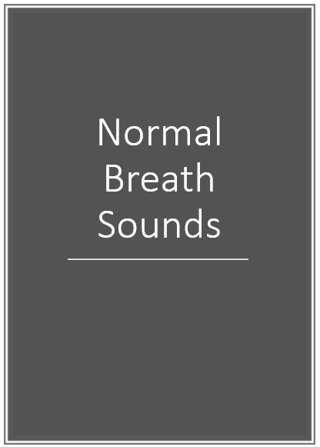
Notes:
Bronchial: Loud and high-pitched with hollow quality. Expiration lasts longer than inspiration (3:2 ratio).
Bronchovesicular: Medium-pitched and blowing sounds of medium intensity. Inspiratory phase is equal to expiratory phase.
Vesicular: Soft, breezy, and low-pitched sounds. Inspiratory phase is 3 times longer than expiratory phase.

Slide 14
Abnormal Breath Sounds
Rales
Rhonchi
Wheezes
Pleural Friction Rub
Notes:
Discuss with group

Slide 15
Dyspnea
At a minimum, vital signs for shortness of breath should include: Temperature, BP, pulse, apical HR (if pulse irregular) Respirations, Oxygen saturation and finger stick glucose (diabetics)
Is the Dyspnea at rest?
Sitting up?
Lying flat?
What else is different?
Edema
Weight increase
Recent behaviors/stress
New Medications
New activity level
Notes:
If a resident presents with Dyspnea, a full evaluation should be completed SOB is new or worsened—prior to calling the physician

Slide 16
Respiratory Care-Airway and Trach
Respiratory Care Plan - The interdisciplinary team including resident and resident representative will develop a person-centered care plan Interventions should be:
Individualized based upon the assessment process
Goals should:
Be clearly stated
Be resident-centered and individualized
Be realistic
Be attainable
Be measurable
Have a timetable for completion or re-evaluation
Ongoing re-evaluation of ineffective /effective interventions
Notes:
Speaker Notes:
Read the slide.
The care plan will be reviewed and revised at the care conference in collaboration with the resident/resident representative and IDT.
The care plan will need to include the problem, need, or strength statements; measurable goal ; and resident specific interventions.

Slide 17
Care Plan Process
Assessment
Person-centered interventions
Communication
Palliative Care
Notes:
Assessment-Ongoing assessment is going to be crucial! Areas to evaluate include:
Shortness of breath and circumstances (at rest, with exertion or exercise, lying flat in bed, etc.)
Cough (productive? How often? Just in morning? Changes? Difficulty bringing up secretions? Pain with cough?)
Sputum (characteristics and any changes)
Circumoral cyanosis or nail bed cyanosis
Anxiety
Fatigue
Insomnia
Weight gain
Weight loss
Edema
Confusion
Vital signs
Respiratory Assessment (is resident using accessory muscles for breathing, forward leaning posture which is typical for a person with COPD)
Rales, rhonchi, wheeze or stridor present upon inspiration or expiration with auscultation
Is there Tactile fremitis or a palpable rattle
Person-centered interventions: It is imperative that we include the resident and/or resident representative in all aspects of the care planning process.
Frequency of evaluation
Parameters for physician notifications (i.e. vitals, oxygen sats, weights)
Pursed lip breathing, deep breathing and coughing if indicated
Postural drainage/percussion as ordered
Frequency of monitoring oxygen
Oxygen use (instructing both resident and all staff the danger of increasing the liter flow beyond physician orders due to potential CO2 retention
Cardiac assessment
Medications (if resident self-administers any oral medications or inhalers, return demonstration)
Diet and exercise interventions
Smoking cessation support
Mental health referrals if indicated
Ongoing evaluation- Based upon the resident individualized condition and care plan directions
Communication- Communication between nurses, nurse to practitioner, resident to nurse, nurse to resident, nurse to care givers and within the IDT
Palliative Care for residents at end stage. This will also provide you with opportunities to once again address resident’s advance directives.
**Please take a few minutes to review one example of a COPD Care Plan

Slide 18
Respiratory Care Critical Element Pathway
Notes:
Speaker Notes
Review and use this pathway for a resident who requires or receives respiratory care services (i.e., oxygen therapy, breathing exercises, sleep apnea, nebulizers/metered-dose inhalers, tracheostomy, or ventilator) to assure that the resident receives proper treatment and care.
Hand-out a copy of the Respiratory Care Critical Element Pathway and discuss.

Slide 19
Interventions for Competency
Assessment Process
Medication Delivery
Oxygen Use
Breathing Exercises
Nebulizers
Tracheostomy Care
APAP
Bi-PAP
CPAP
Mechanical Ventilation
Monitoring for change in condition
Oral Care
Skin Care
Resident Positioning
Humidifiers
Equipment Disinfection
Advance Directives
Notes:
You will each be trained and a process for verification of competency will be completed to ensure you are comfortable and competent in providing care to the residents with respiratory or tracheostomy care needs.

Slide 20
Respiratory Care-Airway and Trach
Small Volume Nebulizers-example replace with facility procedure as needed here
Assemble nebulizer as per manufacturer’s instructions.
Add medication as prescribed by pouring medication into the nebulizer cup.
Use a mask if resident is unable to tolerate a mouthpiece, and an adaptor specific to tracheostomies if the resident has a tracheostomy.
Position resident sitting up in a chair or in bed at greater than 45 degrees.
Assess vital signs and lung sounds before and after the treatment.
Attach the nebulizer to compressed air; use oxygen if there is no compressed air.
If resident is receiving oxygen, do not turn it off. Continue to deliver oxygen through nasal prongs with the nebulizer.
Notes:
Speaker Notes
Read the slide
Single-dose vials for aerosolized medications used for one resident.
Some medications require the addition of sterile water or sterile saline per prescription for dilution.
Some medications may be mixed together if there are no contraindications. Use facility procedure to discuss
Turn on air to nebulizer and ensure that a sufficient mist is visible exiting nebulizer chamber. A flow rate of 6 – 10 liters should provide sufficient misting.
Ensure the medication chamber is securely fastened and connected to the face mask or mouth piece and that the nebulizer tubing is connected to compressed air or oxygen flow meter.
If mouthpiece is being used, ensure lips are sealed around mouthpiece.
Have resident take slow, deep, inspiratory breaths. Encourage a brief 2-3 second pause at the end of inspiration, and continue with passive exhalations.
If resident is dyspneic, encourage holding every fourth or fifth breath for 5 to 10 seconds.
Have resident repeat this breathing pattern until medication is complete and there is no visible misting. This process takes approximately 8 to 10 minutes.

Slide 21
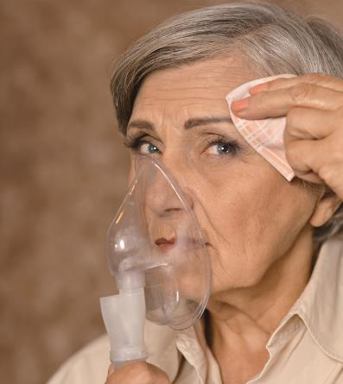
Small Volume Nebulizers
Stay with the resident during the treatment unless the resident has been assessed to be able to safely self-administer the inhalation treatment.
Make sure this assessment is documented in the medical record.
Notes:
Stay with the resident during the treatment unless the resident has been assessed to be able to safely self-administer the inhalation treatment. Make sure this assessment is documented in the medical record.
Tap nebulizer chamber occasionally and at the end of the treatment.
Monitor resident’s pulse rate during treatment, especially if beta-adrenergic bronchodilators are being used.
Rinse, dry, and store nebulizer as per agency policy.
If inhaled medication included steroids, have resident rinse mouth and gargle with warm water after treatment.
Once treatment is complete, encourage patient to perform deep breathing and coughing exercises to help remove expectorate mucous.

Slide 22
Medication Management
Are sterile solutions (e.g., water or saline) used for nebulization;
Are single-dose vials used for only one resident;
If multi-dose vials are used, are manufacturer’s instructions for handling, storing, and dispensing the medications followed;
If multi-dose vials are used for more than one resident, are vials dated when initially accessed, stored appropriately, and do not enter the immediate resident treatment area;
Are jet nebulizers used for only one resident? Are they cleaned and stored per facility policy, rinsed with sterile water, and air-dried between treatments on the same resident;
Are mesh nebulizers that remain in the ventilator circuit cleaned, disinfected, or changed at an interval recommended by manufacturer’s instructions;
Are nebulizers/drug combination systems cleaned and disinfected according to the manufacturer’s instructions?
https://www.cms.gov/Medicare/Provider-Enrollment-and-Certification/GuidanceforLawsAndRegulations/Nursing-Homes.html
Notes:
Sterile solutions should be used
Single-dose vials must be used for only one resident
If multi-dose vials are used and enter the resident’s room—they must be discarded

Slide 23
Tracheostomy Care
If facility is caring for a resident with a trach, insert the facility policy and procedure on Tracheostomy Care Here
Include:
Supplies needed
Step by step instructions
Infection Control (Hand Hygiene, PPE, etc.)
Requirements for physician orders
Unplanned extubation
Emergency procedures
Emergency supplies and location
Regular Trach care
Monitoring of trach site
Suctioning
Cleaning and disinfecting all equipment

Slide 24
Suctioning
Include facility policy and procedure here

Slide 25
Oxygen
Check MD order (date, time, L/min and method of administration)
Perform hand hygiene
Explain purpose and procedures to the patient
Assemble and prepare oxygen equipment per manufacturer recommendation
Set flow meter to MDs ordered flow rate (Licensed Nurse or Respiratory Therapist)
Insert nasal cannula into residents nostrils, adjust tubing behind ears and slide plastic adapter under residents chin.
Maintain enough slack in oxygen tubing
Assess residents response to oxygen and comfort level
Remove gloves and perform hand hygiene
Document the following: date, time, flow rate, method respiratory condition, response to oxygen and sign the documentation when finished.
Notes:
Monitor area around nares and ears for potential pressure concerns—Add facility procedure here

Slide 26
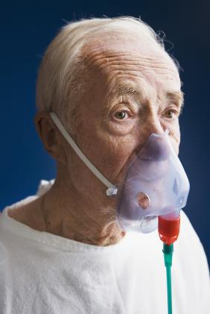
Respiratory Care-Airway and Trach
Oxygen
Make sure that warning signs (OXYGEN - NO SMOKING) are posted Identify State Requirements/Policy
Oxygen must be turned on before the mask is applied to the client.
Make sure the tubing is patent at all times and ensure that that the equipment is working properly.
Notes:
Speaker Notes
Read the slide
Oxygen therapy, also known as supplemental oxygen, is the use of oxygen as a medical treatment. This can include for low blood oxygen, carbon monoxide toxicity, cluster headaches, and to maintain enough oxygen while inhaled anesthetics are given. Long-term oxygen is often useful in people with chronically low oxygen such as from severe COPD or cystic fibrosis. Oxygen can be given in a number of ways including nasal cannula, face mask, and inside a hyperbaric chamber
over- oxygenation can be dangerous for some individuals, Particularly those with chronic lung disease who are retaining carbon dioxide, and infants, where there is also a risk of retinopathy of prematurity (ROP).

Slide 27
Change of Condition
All frontline staff should report any change of condition to the nurse right away
Assessment Process
Reporting
Interventions
Follow Up
Notes:
All frontline staff should report any change of condition to the nurse right away: Use the system you have (i.e. INTERACT)
Use your facility process
Assessment Process
Reporting: To the nurse, to the physician, resident representative, respiratory therapy, etc.
Interventions: Need to be added to the person-centered plan of care
Follow Up: Ensure good follow-up monitoring, assessment and documentation

Slide 28
QAPI and QA
Notes:
Involving the whole team in identification of the types of resident conditions we care for in our facility wide resource assessment is essential in preparing staff and our facility for managing residents with a variety of disease processes in the facility. We need to ensure we have adequate and competent staff, ample supplies and equipment (pulse oximeters, nebulizer machines, etc.) therapy resources, availability for referrals (for example pulmonologists, etc.) to meet the needs of our residents. QAPI or Quality Assurance and Performance Improvement is a process to include staff from all departments, all levels, management and identify areas for quality improvement. Managing residents to provide quality of care is essential in this process.
Begin gathering and analyzing data
Include information from your facility wide resource assessment in the process (types of residents, staff resources, needs, etc.)
Identify trends
Search for gaps in care
Review any advanced care planning steps

Slide 29
Ventilator Care
Notes:
If your facility has a ventilator unit—add your policies and procedures to the next few slides—otherwise remove this slide

Slide 30
Ventilator Care
Insert Facility Specific P&P here

Slide 31
In Summary
Notes:
Summarize the overall training with the team.

Slide 33
References and Resources
Centers for Medicare & Medicaid Services State Operations Manual, Appendix PP – Guidance to Surveyors for Long Term Care Facilities (Rev. 173, 11-22-17): https://www.cms.gov/Regulations-and-Guidance/Guidance/Manuals/downloads/som107ap_pp_guidelines_ltcf.pdf
Centers for Medicare and Medicaid Services, Respiratory Critical Element Pathway. CMS 20081 (7/2018): https://www.cms.gov/Medicare/Provider-Enrollment-and-Certification/GuidanceforLawsAndRegulations/Nursing-Homes.html

Slide 34
Disclaimer
“This presentation provided is copyrighted information of Pathway Health. Please note the presentation date on the title page in relation to the need to verify any new updates and resources that were listed in this presentation. This presentation is intended to be informational. The information does not constitute either legal or professional consultation. This presentation is not to be sold or reused without written authorization.”

