Slide 1
Dementia Care Competency
Staff Training
Notes:
Hello and Welcome to the program on -Dementia Care Competency
NOTE TO SPEAKER: As attendees enter the room, this slide should be on the screen. Be certain each person signs the attendance sheet or uses whatever facility method tracks their attendance at in-services. Introduce yourself and the topic of competency as it relates to the provision of care and services for Behavioral Health.
NOTE TO SPEAKER: Whenever you see the symbol to the left in the speaker’s notes, please read the associated instructions. Whenever you see bold and underlined content in the speaker’s notes, please emphasize this information to the attendees. You could subtly hint that it may be on the test.
Most persons diagnosed with Alzheimer’s disease or other dementias live in the community. Family caregivers typically seek nursing facility care when the burdens of physical care and behavioral care become too demanding and safety cannot be assured.
2014 data from the Centers for Disease Control and Prevention (CDC) indicates 50.4% of nursing facility residents had a diagnosis of Alzheimer’s disease or a related dementia.
F744 Dementia Care in CMS State Operations Manual, Appendix PP, states: “A resident who displays or is diagnosed with dementia, receives the appropriate treatment and services to attain or maintain his or her highest practicable physical, mental, and psychosocial well-being.”

Slide 2
Objectives
Upon completion of the program, attendees should be able to:
Obtain a basic understanding of the Requirement of Participation for Dementia Care competency.
Review the policies and procedures for Dementia Care.
Verbalize understanding of documentation related to Dementia Care.
Notes:
Today’s in-service has 3 objectives:
Obtain a basic understanding of the Requirements of Participation for Dementia Care competency.
The requirement for sufficient and competent staff for Dementia Care is found at F744. You hear about “F tags” when surveyors find deficiencies. “F tags” or “Federal tags” are numbers assigned to the regulations a skilled nursing facility like this one must follow in order to participate in the Medicare and Medicaid programs. The facility has signed a contract with The Centers for Medicare and Medicaid Services (CMS) agreeing to follow the regulations and to allow surveyors to inspect the facility for compliance.
F744 specifically indicates nursing facilities must have sufficient and competent staff who provide direct services to residents who display or are diagnosed with dementia.
Review the policies and procedures associated with Dementia Care.
Residents requiring these services are determined by the resident assessments and individual plans of care. So, we will talk about how we assess and how we develop person-centered care plans.
Meaningful activities addressing the resident’s customary routines, interests, and preferences are expected to be provided since these promote engagement and positive relationships among residents and staff as well as an atmosphere conducive to mental and psychosocial well-being.
Competencies regarding the implementation of non-pharmacologic; i.e., non-drug behavioral interventions are a significant regulatory expectation.
Verbalize understanding of documentation related to Dementia Care.
Not only will documentation help us identify which residents with dementia have Behavioral Health needs, but documentation will also help us identify what care and services work and do not work for each resident.

Slide 3
F744 Dementia Care
The facility MUST provide necessary behavioral health care and services:
Ensuring that the necessary care and services are person-centered and reflect the resident’s goals for care, while maximizing the resident’s dignity, autonomy, privacy, socialization, independence, choice, and safety;
Ensuring that direct care staff interact and communicate in a manner that promotes mental and psychosocial well-being.
Providing meaningful activities which promote engagement, and positive meaningful relationships between residents and staff, families, other residents and the community.
Providing an environment and atmosphere that is conducive to mental and psychosocial well-being;
Ensuring that pharmacological interventions are only used when nonpharmacological interventions are ineffective or when clinically indicated.
https://www.cms.gov/Regulations-and-Guidance/Guidance/Manuals/downloads/som107ap_pp_guidelines_ltcf.pdf
Notes:
CMS – the Centers for Medicare and Medicaid Services – write the requirements, the rules.
CMS states the facility must provide person-centered dementia care. That means caregivers treat each resident as a unique individual and honor their choices. Knowing a resident’s background, routines, likes, dislikes, etc,. are an important part of the assessment and care planning process.
Dementias affect the way the brain functions; so, communication can be difficult. Caregivers need to adapt their usual communication techniques to provide the highest quality dementia care.
Meaningful activities keep residents with dementia engaged and help establish friendships among the residents, staff, families, and the community.
Creating a healthy environment throughout the nursing facility is everyone’s responsibility.
Sometimes, behaviors associated with dementia can be frustrating for caregivers. Non-pharmacologic; i.e., non-drug interventions should be attempted before resorting to new or increased medications.
Those are the rules. Let’s take a closer look at some background information and recommended interventions.

Slide 4
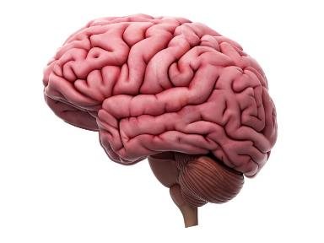
Dementia
Not a specific disease
Not a normal part of aging
Decline in mental ability severe enough to interfere with daily life
Caused by damage to brain cells from disease or trauma
Many dementias are progressive
Notes:
Dementia is a general term for a decline in mental ability severe enough to interfere with daily life.
Dementia is not a specific disease. It’s an overall term that describes a wide range of symptoms and about 90 different conditions associated with a decline in memory or other thinking skills.
Dementia is NOT normal aging.
It is caused by damage to brain cells from disease or trauma (such as a brain injury or stroke). This damage interferes with the ability of brain cells to communicate with each other. When brain cells cannot communicate normally, thinking, behavior, and feelings can be affected.
Many dementias are progressive, meaning symptoms start out slowly and gradually get worse.

Slide 5
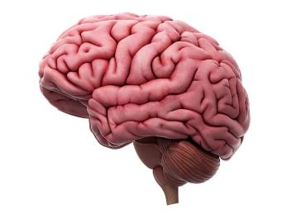
Types of Dementia
Alzheimer’s disease
Vascular dementia
Dementia with Lewy Bodies (DLB)
Mixed dementia
Parkinson’s disease
Frontotemporal dementia
Creutzfeldt-Jakob disease
Normal pressure hydrocephalus
Huntington’s disease
Wernicke-Korsakoff Syndrome
https://www.alz.org/alzheimer_s_dementia
Notes:
There are numerous types of dementia:
Alzheimer’s disease: 50 – 60% of all dementias are Alzheimer’s disease alone or with another dementia. It’s important to get an accurate, thorough diagnosis and not just a screening.
Vascular dementia: This is the second most common type of dementia. This is due to stokes or TIAs, the blood supply to the brain. Emotional issues are common. Or apathy, flat affect is common.
Dementia with Lewy bodies (DLB): Falls are often the first symptom. Visual hallucinations are very common – animals, children, people, dangerous situations. Sleep disturbances. Muscle rigidity or other parkinsonian movement features
Mixed dementia: abnormalities linked to more than one type of dementia occur simultaneously in the brain; researchers increasingly believe a large number of dementia cases are of mixed pathology
Parkinson’s disease: brain changes begin in a region that plays a key role in movement; as changes gradually spread, they often begin to affect mental functions, including memory and the ability to pay attention, make sound judgments and plan the steps needed to complete a task
Frontotemporal dementia: typical symptoms include changes in personality and behavior and difficulty with language; nerve cells in the front and side regions of the brain are especially affected
Creutzfeldt-Jakob disease: rapidly fatal disorder that impairs memory and coordination and causes behavior changes; variant CJD (“mad cow disease”) occurs in cattle and has been transmitted to people under certain circumstances
Normal pressure hydrocephalus: symptoms include difficulty walking, memory loss, and inability to control urination; caused by the buildup of fluid in the brain
Huntington’s disease: progressive brain disorder caused by a single defective gene on chromosome 4; symptoms include abnormal involuntary movements, a severe decline in thinking and reasoning skills, irritability, depression, and other mood changes
Wernicke-Korsakoff Syndrome: a chronic memory disorder caused by severe deficiency of thiamine (vitamin B-1); most common cause is alcohol misuse; memory problems may be strikingly severe while other thinking and social skills seem relatively unaffected
Alzheimer’s disease and vascular dementia are the most common types of dementia.

Slide 6
Alzheimer’s Disease: Overview
Most common type of dementia
60% - 80% of cases
Progressive – symptoms gradually worsen over number of years
https://www.alz.org/alzheimers-dementia/what-is-alzheimers
Notes:
Alzheimer’s disease is the most common type of dementia. It accounts for an estimated 60% to 80% of cases.
Alzheimer’s disease is a progressive disease, in which dementia symptoms gradually worsen over a number of years.
In its mild (early) stages, people experience some memory loss, but with severe (late-stage) Alzheimer’s disease, individuals lose the ability to carry on a conversation and respond to their environment. The degenerative nature of the disease means many in the severe stage have difficulty moving, often become bed-bound, and need around-the-clock care.

Slide 7
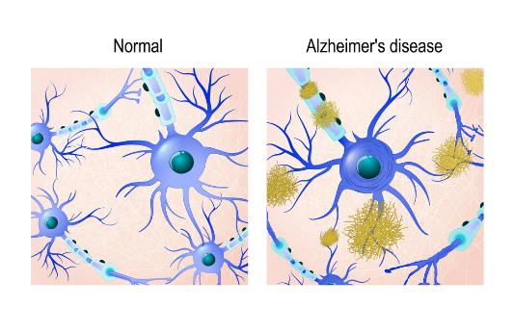
Alzheimer’s Disease: Physical Changes
Brain shrinks dramatically
Nerve cell death
Tissue loss
Plaques: abnormal clusters of protein fragments
Tangles: twisted strands of another protein
https://www.alz.org/alzheimers-dementia/what-is-alzheimers
Notes:
Alzheimer’s disease was first identified in 1906 by Dr. Alois Alzheimer. He noticed certain changes in the brain tissue of a woman who had died after a mental illness that included symptoms of memory loss, language problems, and unpredictable behavior.
Dr. Alzheimer examined her brain after her death and found many abnormal clumps (now called amyloid plaques) and tangled bundles of fibers (now called neurofibrillary, or tau, tangles).
These plaques and tangles in the brain are still considered some of the hallmarks of Alzheimer’s disease, along with the loss of connections between nerve cells (neurons) in the brain.
Alzheimer’s disease leads to nerve cell death and tissue loss throughout the brain. Over time, the brain shrinks dramatically, affecting nearly all its functions.
Scientists are not absolutely sure what causes cell death and tissue loss in the Alzheimer’s brain, but plaques and tangles are prime suspects.
Plaques, abnormal clusters of protein fragments, build up between nerve cells in the brain. Plaques form when protein pieces called beta-amyloid clump together.
Dead and dying nerve cells contain tangles, which are made up of twisted strands of another protein.
Plaques and tangles tend to spread through the brain in a predictable pattern as Alzheimer’s disease progresses.
NOTE TO SPEAKER: The image on the slide shows a microscopic illustration of Alzheimer’s tissue with plaques and tangles.

Slide 8
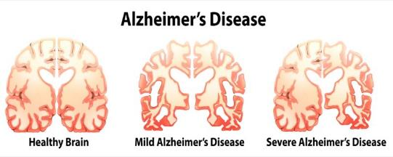
Stages of Alzheimer’s Disease
Average lifespan 4-8 years after diagnosis; as long as 20 years
Progresses slowly in 3 stages:
Mild (early-stage)
Moderate (middle-stage)
Severe (late-stage)
https://www.alz.org/alzheimers-dementia/stages
Notes:
On average, a person with Alzheimer’s disease lives four to eight years after diagnosis, but can live as long as 20 years, depending on many factors (such as the progression of the disease, other co-occurring conditions, infections, and unintentional injuries).
The symptoms of Alzheimer’s disease worsen over time, although the rate at which the disease progresses varies.
Alzheimer’s disease typically progresses slowly in three general stages – mild (early-stage), moderate (middle-stage), and severe (late-stage).
NOTE TO SPEAKER: The image on the slide shows the progression of changes to the brain, from preclinical Alzheimer’s (left), mild to moderate (middle), to severe (right).

Slide 9
Early Stage Alzheimer’s
Able to function independently
Common difficulties:
Forgetting familiar words
Losing everyday objects
Trouble remembering names
Greater difficulty performing tasks
Forgetting material just read
Increasing trouble with planning, organizing
Notes:
In the mild stages of Alzheimer’s disease, a person may function independently. He or she may still drive, work and be part of social activities.
Despite this, the person may feel as if he or she is having memory lapses, such as forgetting familiar words or the location of everyday objects.
Other common difficulties in the mild stage of Alzheimer’s disease include:
Trouble remembering names when introduced to new people
Having greater difficulty performing tasks in social or work settings
Forgetting material that one has just read
Increasing trouble with planning or organizing
Many times, family members take on more and more caregiving responsibilities as Alzheimer’s disease progresses. Family members can share background information about the person – what the person was like before the diagnosis and after the diagnosis. They can share what things have worked regarding preventing or managing behaviors and what things have frustrated them. It may be quite difficult for the family member to turn the role of caregiver over to the staff. Find ways to acknowledge the family member and keep lines of communication open and supportive.

Slide 10
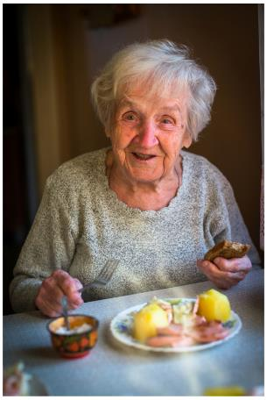
Middle Stage Alzheimer’s
Requires increasing care
Symptoms include:
Forgetfulness of personal history
Confusion about place or time
Need for help with bathing, toileting, dressing
Changes in sleep patterns
Increased risk of wandering
Personality and behavioral changes
Notes:
As the disease progresses, a person with Alzheimer’s disease will require a greater level of care.
In the moderate stage, damage to nerve cells in the brain can make it difficult to express thoughts and perform routine tasks.
During this stage, symptoms will be noticeable to others and may include:
Forgetfulness of events or about one’s own personal history
Confusion about where they are or what day it is
The need for help choosing proper clothing for the season or the occasion
Trouble controlling bladder and bowels in some individuals
Changes in sleep patterns, such as sleeping during the day and becoming restless at night
An increased risk of wandering and becoming lost
Personality and behavioral changes, including suspiciousness and delusions or compulsive, repetitive behavior like hand-wringing or tissue shredding

Slide 11
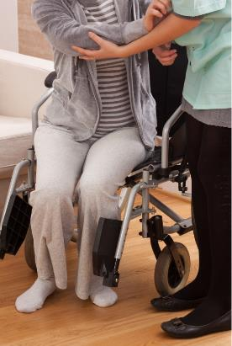
Late Stage Alzheimer’s
Typically longest stage
Requires full-time care
Loss of awareness of recent experiences and surroundings
Changes in physical abilities (walking, sitting, swallowing)
Vulnerable to infections
Notes:
The severe stage of Alzheimer’s disease is typically the longest stage and can last for many years.
In the severe stage of Alzheimer’s disease, individuals lose the ability to respond to their environment, to carry on a conversation, and, eventually, to control movement.
They may still say words or phrases, but communicating becomes difficult.
As memory and cognitive skills continue to worsen, personality changes may take place, and individuals need extensive help with daily activities.
At this stage, individuals may:
Require full-time, around-the-clock assistance with daily personal care
Lose awareness of recent experiences as well as of their surroundings
Experience changes in physical abilities, including the ability to walk, sit, and eventually, swallow
Become vulnerable to infections, especially pneumonia

Slide 12
Person-Centered Care
Approaches designed to meet the individual needs of each resident
The person is in control.
The staff support the resident in making their own choices and having control over their daily lives.
The key is to understand how the resident “sees” and “feels” the world around them.
Notes:
As caregivers, you will meet many people who have been diagnosed with Alzheimer’s disease or other dementias. You will see similar behaviors among them, but we must realize that each person is an individual and brings different life experiences and ways of interacting with their environment.
Person-centered care is a philosophy of care that has been integrated into the requirements of participation, the rules nursing facilities must follow. The fundamental idea is the person is in control. The staff’s responsibility is to support the resident in making choices and having control over their daily lives.
To provide person centered care, caregivers need to put themselves in the resident’s shoes. That will help them see and feel the world around them.

Slide 13
Approach to Care
Comprehensive assessment and care planning
Understanding the behavior
Effective communication
With the resident
With the team
Strategies for implementing person-centered care rely on having effective staff approaches and an environment conducive to carrying out recommended care practices.
Notes:
So, let’s review the overall approach to person-centered care.
We need a thorough assessment and a detailed care plan. An Interdisciplinary Team approach is essential! Everyone working with persons with dementia needs to know best practices related to behavior management, communication, use of medications, and therapeutic environments.

Slide 14
Comprehensive Assessment
Notes:
Everyone contributes information to complete the MDS and other assessments and then to develop the care plan. The care plan provides directions to anyone who provides care and services to that resident and should contain very specific information about what name they like to be called, how they like to spend their day, preferences regarding bathing, sleeping, eating, activities.
Section C of the MDS contains the BIMS (Brief Interview of Mental Status) which asks the person to repeat the words “sock, blue, bed”; tell the year, month, and date, and then recall “sock, blue, bed.” If the resident can’t or won’t participate in this interview, someone will ask the staff to assess the person’s short-term and long-term memory; recall of current season, location of room, staff names/faces, that they are in a nursing home; and their ability to make decisions regarding tasks of daily living.
Section D of the MDS is a mood interview that addresses feelings of depression over the previous 2 weeks. Here, again, if the person can’t or won’t participate in the interview, someone will ask staff members about the presence and frequency of symptoms over the past 2 weeks. These include activity participation, sleeping, appetite, energy level, being short-tempered, self-defeating comments.
Section E is about behaviors. We will talk more a bit later about identifying and managing behaviors; but sometimes caregivers don’t do a very good job of even noticing or documenting behaviors for persons with dementia. It seems as if the behaviors are just an expected part of the disease or the person. Staff make remarks such as, “Oh, that’s just Joe,” or “Sara always hits someone if they sit to close to her.”
Section E asks about the presence of hallucinations and delusions.
Hallucinations deal with the 5 senses: sight, hearing, taste, smell, and touch. A person seeing, hearing, tasting, smelling, or sensing the touch of something for which there is no stimulus is having an hallucination. For example, they see small people dressed in green suits on the patio or they hear air raid sirens.
Delusions are fixed beliefs that are firmly held and are contrary to reality. An example might be that a resident believes another resident is their spouse; however, the actual spouse is deceased.
Section E also addresses physical behaviors, verbal behaviors, and behaviors not directed toward others.
Physical behaviors will be those involving hitting, kicking, pinching, poking, grabbing, and sexual abuse.
Verbal behaviors are threats, cursing, screaming at others, using crude or rude gestures.
Other behaviors might involve hitting, scratching, or cutting oneself, pacing, rummaging, pubic sexual acts like masturbation, throwing or smearing food or urine/feces, disruptive sounds.
Rejection of care is also included in Section E. When documenting and care planning this, it’s important to determine whether the person is rejecting the care or making a choice not to receive the care. As direct caregivers, you know that sometimes you or another caregiver may approach a resident at a different time of day or in a different manner and the resident will not reject the care.
And finally, Section E also addresses wandering behavior.
Each of these behaviors is further assessed to determine the impact upon the resident, upon other persons (other residents, staff), and upon the environment. Without documentation about specific behaviors – even if they are “usual” behaviors for a resident – and the intensity and frequency, we cannot develop an appropriate care plan.
Section F of the MDS addresses Activities -- but not just recreational activities. Usually, Activity Department staff will interview the resident or the resident representative about their preferences while they reside in the facility.
Ask the attendees:
“Do you think residents may have fewer and less intense behavior episodes if caregivers allowed them to go to bed and to get up at the hours they were used to? If they were able to take a shower or a bath at the same time of day they usually did at home? If they listened to or watched the same radio or TV stations they did at home? If they wore preferred clothing styles, colors?
Section G of the MDS addresses ADLs. It is important to document exactly what the resident does each time an ADL is performed. Don’t residents sometimes need more help on evening shift than on day? Or their ADL performance might vary from one day to the next? Caregivers need to document this. How else can we get an accurate care plan?

Slide 15
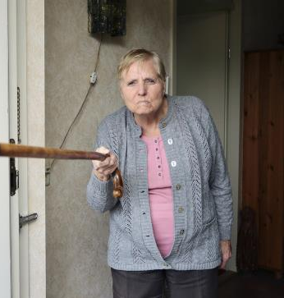
Behavior Concerns
Behavior issues may cause distress to the resident and/or others or they may put the resident and/or others at risk for physical or psychological harm.
Physical behaviors toward others
Verbal behaviors toward others
Other behaviors, not directed at others
Behaviors not covered in RAI categories
If a behavior does not cause distress or increase risk for harm, there is no need to manage it.
Notes:
Behavior issues may cause distress to the resident and/or others or they put the resident and/or others at risk for physical or psychological harm.
Earlier, we talked about the MDS and Section E dealing with physical behaviors toward others, verbal behaviors toward others, etc.
If a behavior exists and if it does not cause distress or increase risk for harm for the resident or others, there is no need to “manage” it.
On the other hand, if the behavior does cause distress or increase risk for harm for the resident or others, there is a need to “manage” it. And by “managing” it; let’s assume that means we need to develop a care plan.

Slide 16
Impact of the Body’s Physical Sensations
Dementias are brain diseases
The disease affects the brain’s ability to interpret signals sent by the body
Behaviors may result
Notes:
Since dementia is a disease of the brain, the resident’s brain may lose the ability to understand signals sent by the body. These misunderstandings can lead to specific behaviors.

Slide 17
All Behavior Has Meaning
Pain
Irritability or rejection of care
Illness
Any and all behaviors
Fatigue
Hungry/Thirsty
Need to Void
Strike out, withdraw, yell out, reject care
Wander or rummage
Agitation or pacing
Notes:
If the resident is having pain, they may strike out, withdraw, yell out, or reject care.
If a resident is hungry or thirsty, they may wander or rummage.
Agitation and pacing may indicate a need to use the bathroom.
Irritability or rejection of care could be fatigue or exhaustion.
And physical illness of any kind could elicit any and all behaviors.

Slide 18
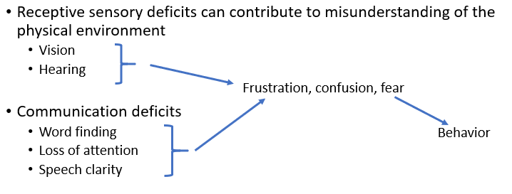
Impact of Sensory Deficits
Notes:
As we age, visual acuity and hearing acuity decrease; but because of the changes in the brain due to dementia, there is an additional layer of difficulty. Poor vision and/or hearing can contribute to misunderstandings and lead to frustration, confusion, or fear.
Difficulty with word finding, loss of attention, and speech clarity can also lead to frustration, confusion, and fear.

Slide 19
Impact of Psychological Needs
Notes:
Because of the changes in the brain of persons with dementia, they may not be able to interpret their psychological needs.
Boredom or loneliness can lead to restlessness, agitation, wandering, or elopement.
Worry and fear can result in verbal or physical behaviors toward other persons.

Slide 20
Notes:
The brain changes due to dementia affect the person’s ability to understand their environment.
Too much noise and stimulation can result in agitation, anxiety, or restlessness. Crowded dining rooms or activity areas, constant TVs or radios, overhead paging, and alarms are common behavior triggers.
Dim lighting or reflective glass or mirrors can produce fear, anxiety, verbal or physical behaviors toward others. Could certain areas of the facility be improved with better lighting? Could mirrors be covered or removed? Are window shades or curtains pulled closed when there is glare?
And caregiver approaches that might startle, confuse, or overwhelm a resident can produce fear, anxiety, reflexive striking out, or verbal behaviors toward others. Some examples of caregiver approaches are:
Touching a resident before announcing your presence or telling the resident what you are going to do
Pulling or pushing a resident’s wheelchair without telling the resident
Using jokes or sarcasm

Slide 21
Impact of the Environment
Institutional routines and expectations for behavior that do not fit the person’s current level of ability and longstanding habits
Frustration, feeling misunderstood or undervalued, depression, withdrawal, anger, frustration
Any and all behaviors may be triggered
Notes:
Remember, the person is in control with person-centered care. Attempting to “make” a resident perform to the staff’s needs or schedules can result in a variety of feelings and behaviors.
Examples of facility routines and expectations include the following:
Bath schedules that do not take into account resident preferences regarding type, time, frequency
Bed times, such as everybody in bed before night shift arrives
Get up times or no breakfast available
“Everybody likes Bingo!”

Slide 22
Communication Problems Associated with Alzheimer’s
Finding the right word or losing his or her train of thought when speaking
Understanding what words mean
Paying attention during long conversations
Remembering the steps in common activities, such as cooking a meal, paying bills, or getting dressed
Blocking out background noises from the radio, TV, or conversations
Frustration if communication isn’t working
Being very sensitive to touch and to the tone and loudness of voices
Forget a language
Notes:
Communication – maintaining engagement – is a critical part in the daily care of persons with dementia. As caregivers, we must be able to adjust our verbal and non-verbal communication techniques to provide the highest quality of care and services.
This requires us to have a high degree of self-awareness about body language, facial expressions, posture, tone of voice, sentence structure and length.
We must remember that a person with dementia has greater difficulty in translating what we say and then creating and giving a response. It will definitely take longer to process.
Communication is hard for people with Alzheimer’s disease because they have trouble remembering things. They may struggle to find words or forget what they want to say. You – the caregiver -- may feel impatient and wish they could just say what they want, but they can’t.
Also, Alzheimer’s disease causes some people to get confused about language. For example, the person might forget or no longer understand English if it was learned as a second language. Instead, he or she might understand and use only the first language learned, such as Spanish.
Tips to make communication easier include calling the person by the name they want to be called and making eye contact. Be aware of how close you are standing, your facial expression, where your hands are, the loudness of your voice and its tone.
Remember to give time for a response. Gentle touch may be O.K. If you are uncertain, try extending your hand as if to shake hands or offer your hand palm up so the person with dementia can choose to take it or not take it.
If the person doesn’t want to communicate, try distraction – offer a drink, sing, etc. Maybe you need to cut down on background noise – turn off the TV, go to their room – so they can concentrate on your conversation.
Pay attention to the person. If you can’t make out the words, try to identify the feeling – mad, glad, sad, afraid. Keep it simple. Say, “Sam, I see you are mad.”
Even if the person with dementia doesn’t speak or you believe they do not understand what you are saying, caregivers must still tell the resident what they are going to do. Break things down into simple steps with simple instructions and wait for a response.
Don’t speak to another caregiver as if the resident isn’t there.
And by all means, don’t use “baby talk” or a “baby voice.” You are providing care for an adult.

Slide 23
Make Communication Easier
Understand
It’s the disease, not the person
It is easier for you to change your techniques than it is for the person who has dementia
Notes:
The first step in making communication easier is to understand that the disease causes changes in communication skills. Therefore, it is up to the caregivers to change their techniques.
Note to Speaker: Use the following demonstration.
Say, “Someone in the middle stages of Alzheimer’s Disease can take 30 seconds to respond to a question. If I asked one of you, ‘How are you?’, chances are you would respond pretty quickly with, ‘I’m good.’ But if you had dementia, a simple question such as this might require much more processing time. Let’s try it.”
Select an attendee and explain that this person has middle stage AD. Tell the person not to respond to your question until the person beside them touches their arm. Tell the person beside them to use the clock on the wall or a watch to time 30 seconds after you ask the question, “How are you?”.
During the 30 seconds, you may look directly at the first attendee, smile, nod, but do not say anything else. When the second attendee touches the first attendee’s arm in recognition of 30 seconds elapsing, you may have to tell the first attendee to answer.
Ask attendees how long that 30 seconds seemed.
Remind them of the common things caregivers sometimes do at meals by doing the following role play. Say each sentence right after the previous one with no time between them.
“Sadie, how are you doing today?”
“Here’s your lunch tray; and look what we have: turkey, green beans, mashed potatoes and gravy.”
“Do want me to cut your turkey for you?”
“Do you like sugar in your coffee or not?”
“Sadie, leave that cherry pie for later. You need to eat your meat and vegetables first. I’m going to put it over here on the counter.”
Ask attendees what, if anything, Sadie remembers about the conversation and why she may not make any response.

Slide 24
Be Direct, Specific, and Positive
“Let’s try this way,’
Instead of pointing out mistakes.
“Please do this,”
Instead of “Don’t do this.”
“Thanks for helping,”
Even if the results aren’t perfect.
Notes:
NOTE TO SPEAKER: Read the slide.
Ask questions that require a yes or no answer.
Say, “Are you tired?” instead of “How do you feel?”
Limit the number of choices.
Say, “Would you like hamburger or chicken for dinner?” instead of “What would you like for dinner?”
Use different words if he or she doesn’t understand the first time.
If you ask the person if he or she is hungry and you don’t get a response, say, “Dinner is ready now. Let’s eat.”
Try not to say, “Don’t you remember?” or “I told you.

Slide 25
10 Principles of Intervention
Know the person “behind the disease” and individualize care.
Understand that no two people or situations (even with the same person) are the same.
Focus on the person, not the task.
Pause to assess the person and the situation.
Break tasks into steps, allowing the person to do what he or she can do individually
Notes:
Person-centered care takes knowledge, skills, and abilities. Here are 10 basic principles of behavioral intervention.
First, we need to know the person “behind the disease.” We need to know their social and psychological history.
Second, behavioral interventions are not a “one size fits all.” What works for one resident may or may not work for another resident. And what worked this morning may not work this evening for the same resident. So, we need to have a lot of different tools in our tool box.
As caregivers, we need to focus on the person, their abilities and their feelings, and not on the task at hand. Take your time. Don’t rush. Pause and assess the person and the environment.
Getting the resident to participate in the task is always a good thing to do. Task segmentation or breaking the task down into smaller steps is a good method to try. Rather than saying, “Martha, brush your teeth,” begin by saying, “Martha, pick up the toothbrush,” and then take it one step at a time.

Slide 26
10 Principles of Intervention
Respond
6. Respond to the person’s emotions; don’t argue logically.
Use
7. Use the person’s agenda.
Slow down
8. Slow down; follow the person’s lead.
Redirect
9. Redirect the person with a positive approach.
Leave and try
10. If things are not going well, leave and try again later.
Notes:
Never argue with someone with dementia. It will frustrate both of you. Respond to the resident’s emotions. Keep it very basic – Are they mad, sad, glad, or afraid? Keep calm. Keep your voice soothing.
Let the resident have control over some part of the situation. Remember to keep both you and them safe.
Keep your movements and responses slow. If they are walking, walk in the same direction; gain their attention; re-direct them by suggesting something positive: “Let’s sit down for a moment,” “Would you like a cup of coffee?” “Let’s go somewhere warm.”
If things are not going well, make certain the person is safe; leave; try again later.

Slide 27
Self-Management
Caring for a person with dementia can be challenging and stressful.
Be aware of your own verbal and non-verbal communication.
Think about what you say and how you say it.
Use directions or explanations that are appropriate for the person and the situation.
Respond to the person’s feeling.
Tune in to your own feelings and attitudes about what is going on.
Do not take behaviors personally.
If you can’t get your own feelings under control, alert other staff and take a break if needed.
Notes:
Caring for a person with dementia can be challenging and stressful. It involves a team of people who look out not only for the persons with dementia but also look out for themselves and their team mates.
Communication is important. Think about the content, the volume, the tone of your voice. We talked about body language, personal space, and announcing your presence before touching or moving a resident. Use short, simple sentences. Respond to feelings – mad, sad, glad, fear.
Self-knowledge is important. Be aware of your own attitudes, feelings, and triggers. Remember that getting angry will not help a situation and may make things worse.
Always remember not to take behaviors from a person with dementia personally. Remain calm, cool, and collected. Remind yourself that the brain disease is causing a behavior: "This person is uncomfortable and needs my help." "I can handle this. I don't need to get upset too." "They're not really angry with me. They're just upset and I'm in the way.“
Caregivers watch out for each other. You have back up. Ask for help if you need it and offer help if you see a need for it.

Slide 28
In Summary
Notes:
Summarize the overall training with the team. Discuss Dementia care, stages of Alzheimer's, approach to care, behaviors and dementia and staff roles and responsibilities

Slide 30
References and Resources
Centers for Medicare & Medicaid Services State Operations Manual, Appendix PP – Guidance to Surveyors for Long Term Care Facilities (Rev. 173, 11-22-17): https://www.cms.gov/Regulations-and-Guidance/Guidance/Manuals/downloads/som107ap_pp_guidelines_ltcf.pdf
LTC Survey Pathways (Download) https://www.cms.gov/medicare/provider-enrollment-and-certification/guidanceforlawsandregulations/nursing-homes.html
Centers for Medicare & Medicaid Services Long-Term Care Facility Resident Assessment Instrument 3.0 User’s Manual, Version 1.16. October 2018: https://www.cms.gov/Medicare/Quality-Initiatives-Patient-Assessment-Instruments/NursingHomeQualityInits/MDS30RAIManual.html

Slide 31
References and Resources
CMS Hand In Hand: A Training Series for Nursing Homes https://surveyortraining.cms.hhs.gov/pubs/HandinHand.aspx
Alzheimer’s Association
https://www.alz.org/

Slide 32
Disclaimer
“This presentation provided is copyrighted information of Pathway Health. Please note the presentation date on the title page in relation to the need to verify any new updates and resources that were listed in this presentation. This presentation is intended to be informational. The information does not constitute either legal or professional consultation. This presentation is not to be sold or reused without written authorization.”

